Slide 1
Dirac Like Quantum Equation for Free Particles of Any Spin in a Global Space-time
Amnon Moalem
Ben Gurion University Of The Negev
Beer Sheva, Israel
Amnon.moalem@gmail.com
IARD, Espoo, Finland, 2-6 June 2024

Slide 2
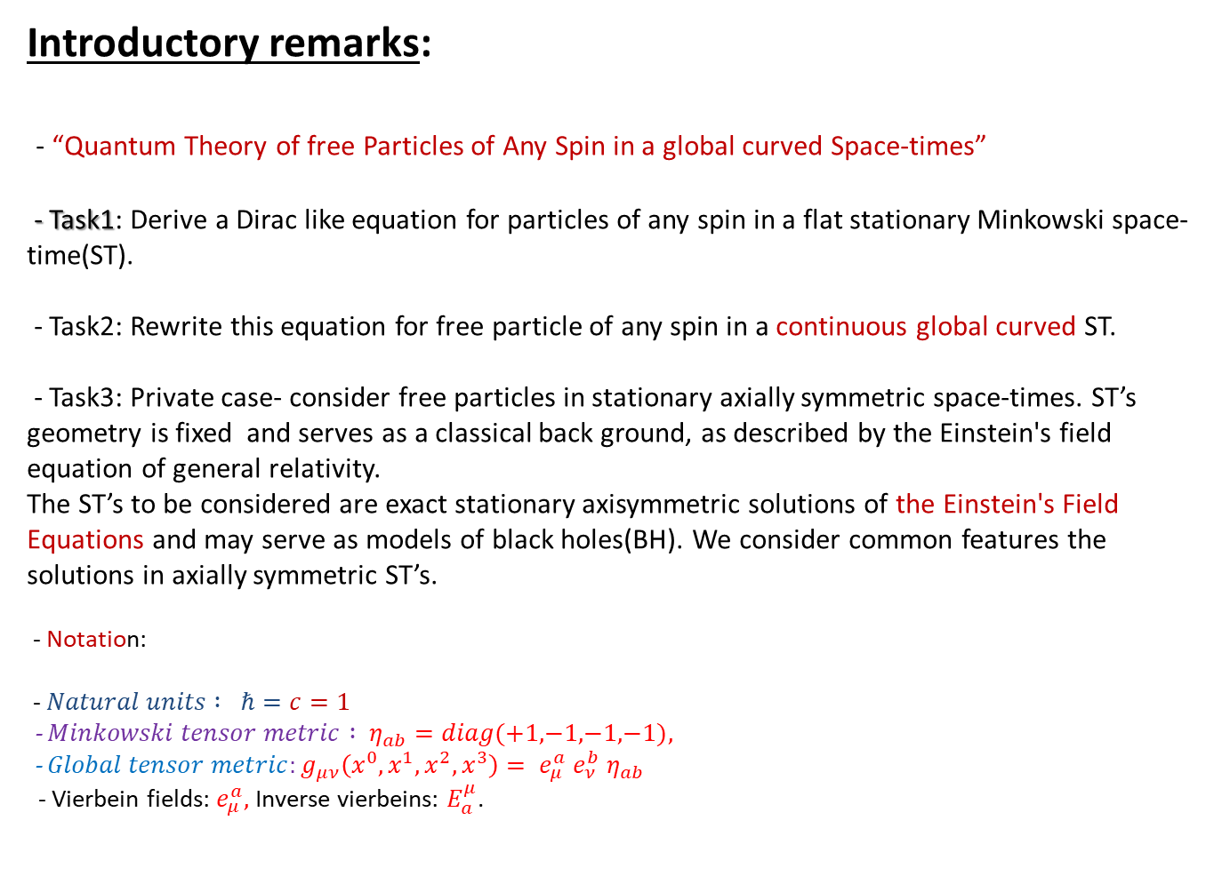
Introductory remarks:
- “Quantum Theory of free Particles of Any Spin in a global curved Space-times”
- Task1: Derive a Dirac like equation for particles of any spin in a flat stationary Minkowski space-time(ST).
- Task2: Rewrite this equation for free particle of any spin in a continuous global curved ST.
- Task3: Private case- consider free particles in stationary axially symmetric space-times. ST’s geometry is fixed and serves as a classical back ground, as described by the Einstein's field equation of general relativity.
The ST’s to be considered are exact stationary axisymmetric solutions of the Einstein's Field Equations and may serve as models of black holes(BH). We consider common features the solutions in axially symmetric ST’s.
- Notation:
- $Natural units : ℏ=c=1$
- $Minkowski tensor metric : η_{ab}=diag\text{(+}\text{1}\text{,}\text{−}\text{1}\text{,}\text{−}\text{1}\text{,}\text{−}\text{1}\text{)},$
- $Global tensor metric:g_{μν}\left(x^{0},x^{1},x^{2},x^{3}\right)= e_{μ}^{a} e_{ν}^{b} η_{ab}$
- Vierbein fields: $e_{μ}^{a},$Inverse vierbeins: $E_{a}^{μ}$.

Slide 3
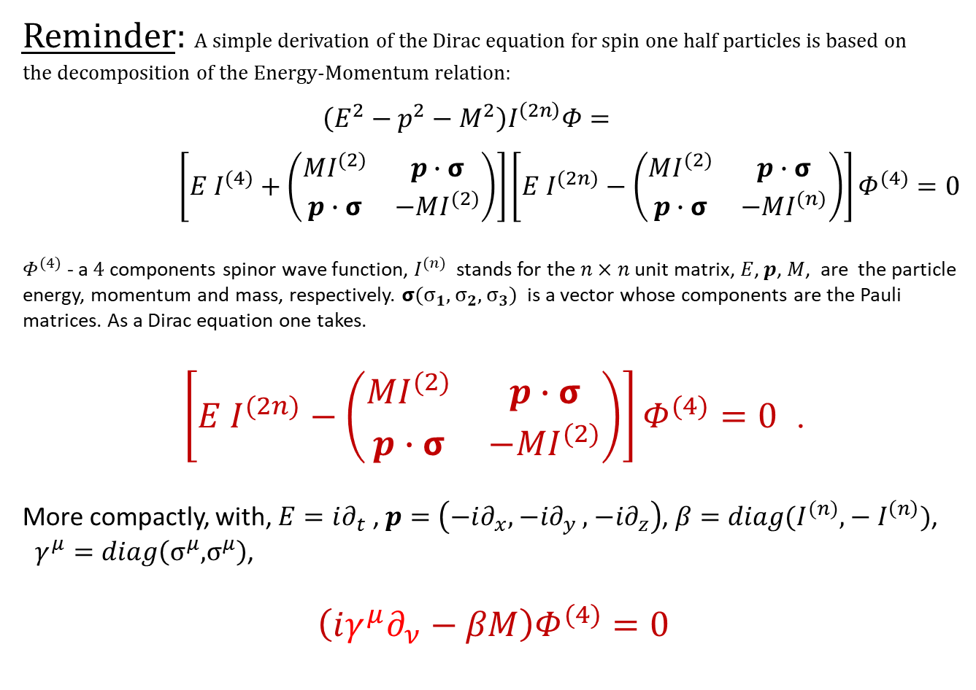
Reminder: A simple derivation of the Dirac equation for spin one half particles is based on the decomposition of the Energy-Momentum relation:
$$\left(E^{2}−p^{2}−M^{2}\right)I^{\left(2n\right)}Φ=$$
$\left[E I^{(4)}+\left(\begin{matrix}MI^{(2)} & p∙σ \\ p∙σ & −MI^{(2)}\end{matrix}\right)\right]\left[E I^{(2n)}−\left(\begin{matrix}MI^{(2)} & p∙σ \\ p∙σ & −MI^{(n)}\end{matrix}\right)\right]Φ^{(4)}=0$
$Φ^{(4)}$ - a $4$components spinor wave function, $I^{(n)}$ stands for the $n×n$ unit matrix, $E$, $p$, $M$, are the particle energy, momentum and mass, respectively. $σ(σ_{1},{ σ}_{2},{ σ}_{3})$ is a vector whose components are the Pauli matrices. As a Dirac equation one takes.
$\left[E I^{(2n)}−\left(\begin{matrix}MI^{(2)} & p∙σ \\ p∙σ & −MI^{(2)}\end{matrix}\right)\right]Φ^{(4)}=0$ .
More compactly, with, $E=i∂_{t}$ , $p=\left(−i∂_{x},{−i∂}_{y}, {−i∂}_{z}\right)$, ${β=diag(I}^{(n)},−I^{\left(n\right)})$,
$γ^{μ}=diag\left(σ^{μ},σ^{μ}\right)$,
$$\left(iγ^{μ}∂_{ν}−βM\right)Φ^{(4)}=0$$

Slide 4
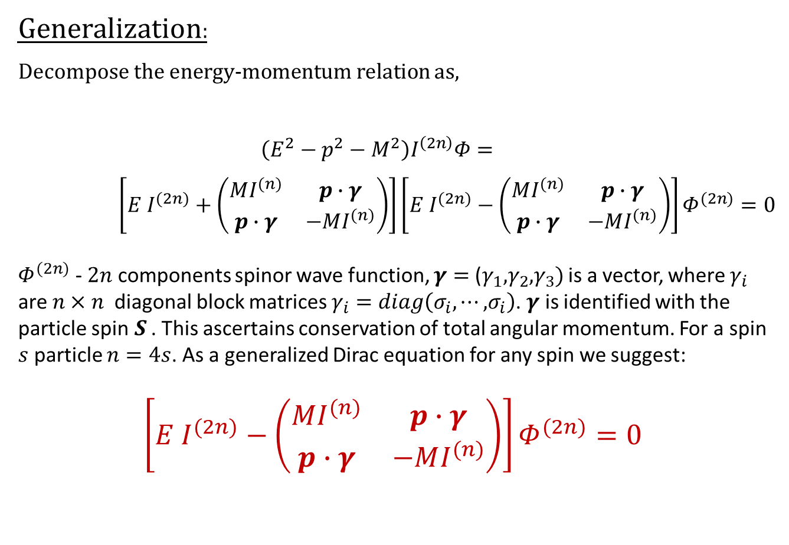
Generalization:
Decompose the energy-momentum relation as,
$$\left(E^{2}−p^{2}−M^{2}\right)I^{\left(2n\right)}Φ=$$
$\left[E I^{(2n)}+\left(\begin{matrix}MI^{(n)} & p∙γ \\ p∙γ & −MI^{(n)}\end{matrix}\right)\right]\left[E I^{(2n)}−\left(\begin{matrix}MI^{(n)} & p∙γ \\ p∙γ & −MI^{(n)}\end{matrix}\right)\right]Φ^{(2n)}=0$
$Φ^{(2n)}$ - $2n$ components spinor wave function, $γ=$ ($γ_{1},γ_{2}, γ_{3})$ is a vector, where $γ_{i}$ are $n×n$ diagonal block matrices $γ_{i}=diag\left(σ_{i}, ⋯, σ_{i}\right)$. $γ$ is identified with the particle spin$S$ . This ascertains conservation of total angular momentum. For a spin $s$ particle $n=4s$. As a generalized Dirac equation for any spin we suggest:
$\left[E I^{(2n)}−\left(\begin{matrix}MI^{(n)} & p∙γ \\ p∙γ & −MI^{(n)}\end{matrix}\right)\right]Φ^{(2n)}=0$

Slide 5
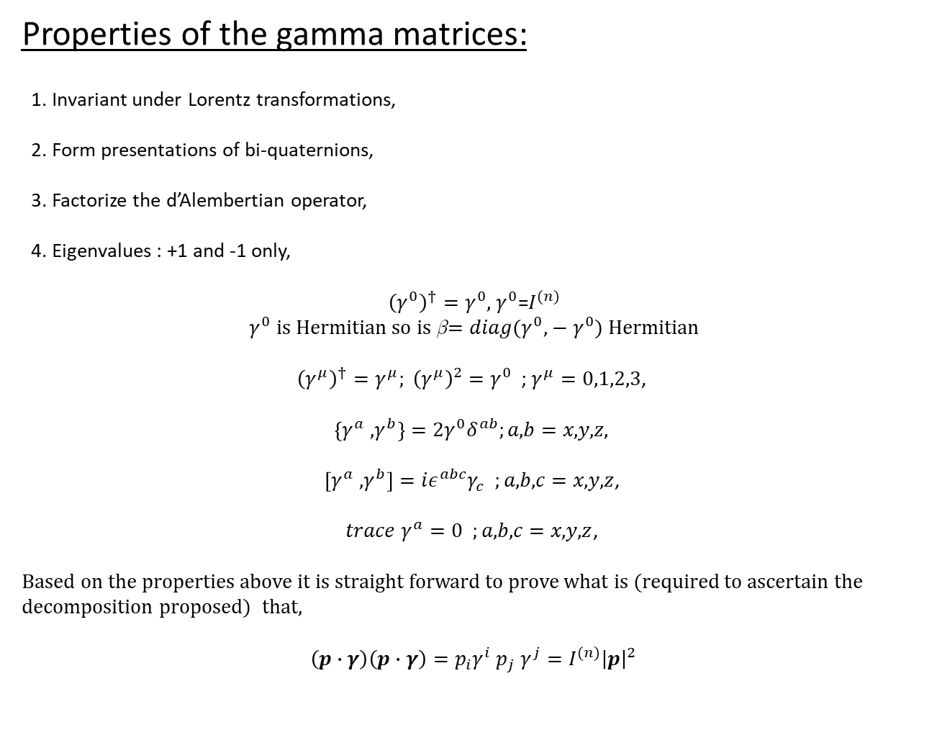
Properties of the gamma matrices:
1. Invariant under Lorentz transformations,
2. Form presentations of bi-quaternions,
3. Factorize the d’Alembertian operator,
4. Eigenvalues : +1 and -1 only,
${\left(γ^{0}\right)}^{†}=γ^{0},$ $γ^{0}$=$I^{(n)}$
$γ^{0}$ is Hermitian so is β$=diag(γ^{0},−γ^{0}$) Hermitian
${\left(γ^{μ}\right)}^{†}=γ^{μ}; {\left(γ^{μ}\right)}^{2}=γ^{0}$ ; $γ^{μ}=0,1,2,3$,
$\left\{γ^{a} , γ^{b}\right\}=2γ^{0}δ^{ab};a,b=x,y,z,$
$\left[γ^{a} , γ^{b}\right]=iε^{abc}γ_{c} ;a,b,c=x,y,z$,
$trace γ^{a}=0 ;a,b,c=x,y,z$,
Based on the properties above it is straight forward to prove what is (required to ascertain the decomposition proposed) that,
$$\left(p∙γ\right)\left(p∙γ\right)={p_{i}γ}^{i} p_{j} γ^{j}=I^{(n)}{\left|p\right|}^{2}$$

Slide 6
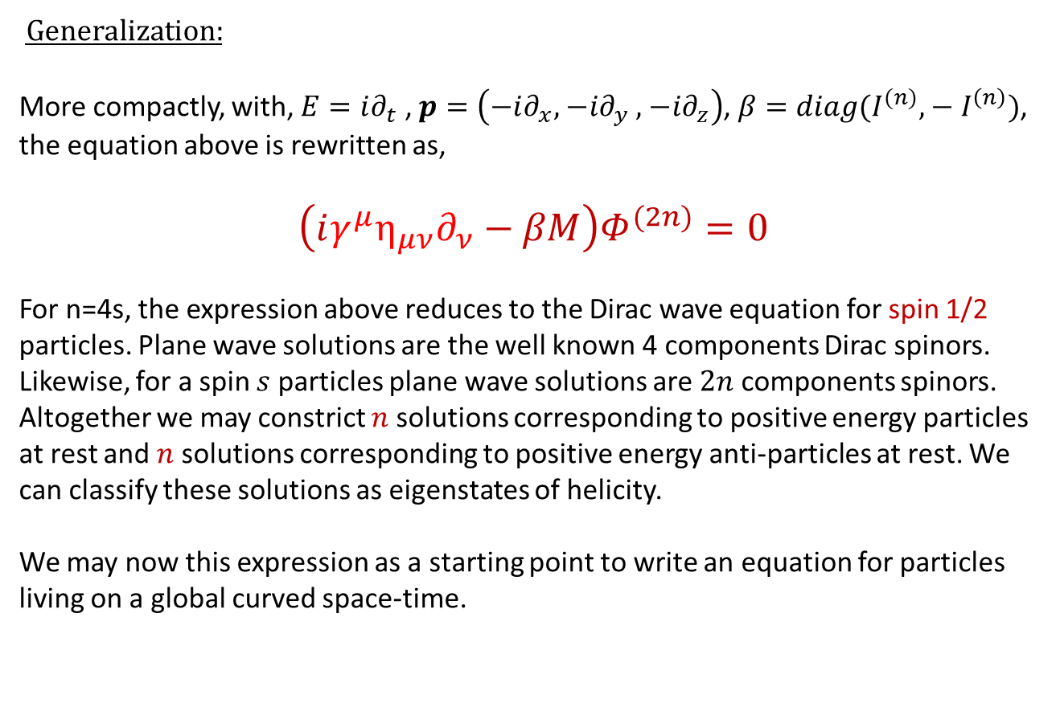
Generalization:
More compactly, with, $E=i∂_{t}$ , $p=\left(−i∂_{x},{−i∂}_{y}, {−i∂}_{z}\right)$, ${β=diag(I}^{(n)},−I^{\left(n\right)})$, the equation above is rewritten as,
$$\left(iγ^{μ}{η_{μν}∂}_{ν}−βM\right)Φ^{(2n)}=0$$
For n=4s, the expression above reduces to the Dirac wave equation for spin 1/2 particles. Plane wave solutions are the well known 4 components Dirac spinors. Likewise, for a spin $s$ particles plane wave solutions are $2n$ components spinors. Altogether we may constrict $n$ solutions corresponding to positive energy particles at rest and $n$ solutions corresponding to positive energy anti-particles at rest. We can classify these solutions as eigenstates of helicity.
We may now this expression as a starting point to write an equation for particles living on a global curved space-time.

Slide 7
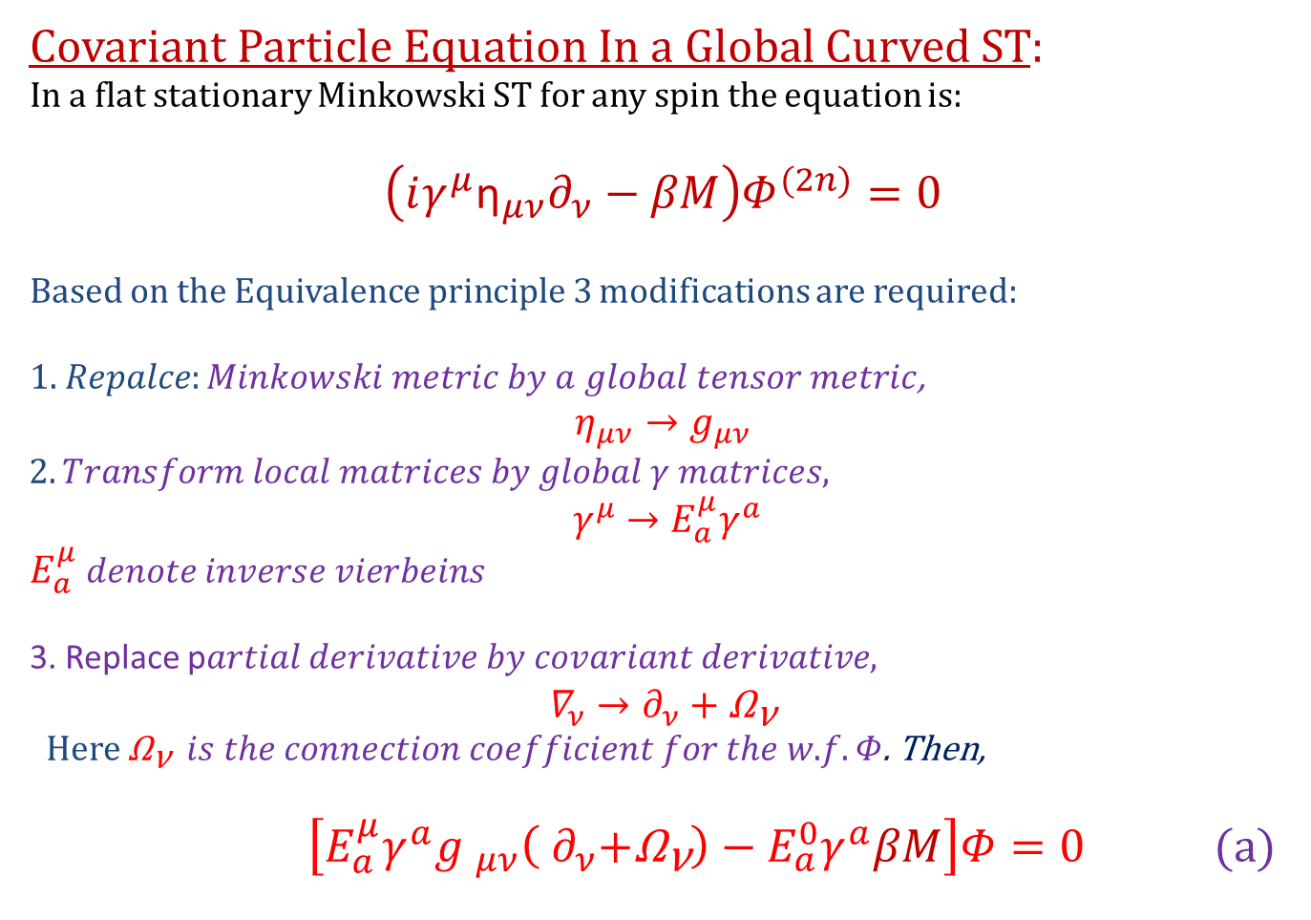
Covariant Particle Equation In a Global Curved ST:
In a flat stationary Minkowski ST for any spin the equation is:
$$\left(iγ^{μ}{\text{η}}_{μν}∂_{ν}−βM\right)Φ^{(2n)}=0$$
Based on the Equivalence principle 3 modifications are required:
$1. Repalce:Minkowski metric by a global tensor metric$,
$$η_{μν}→g_{μν}$$
$$2. Transform local matrices by global γ matrices,$$
$${ γ}^{μ} →E_{a}^{μ}γ^{a}$$
$E_{a}^{μ}$ $denote inverse vierbeins$
3. Replace p$artial derivative by covariant derivative,$
$$∇_{ν}→∂_{ν}+{\text{Ω}}_{\text{ν}}$$
Here ${\text{Ω}}_{\text{ν}} is the connection coefficient for the w.f. Φ$. Then,
$\left[{E_{a}^{μ}γ^{a}g }_{μν}\left({ ∂}_{ν}+{\text{Ω}}_{\text{ν}}\right)−E_{a}^{0}γ^{a}βM\right]Φ=0$ (a)

Slide 8
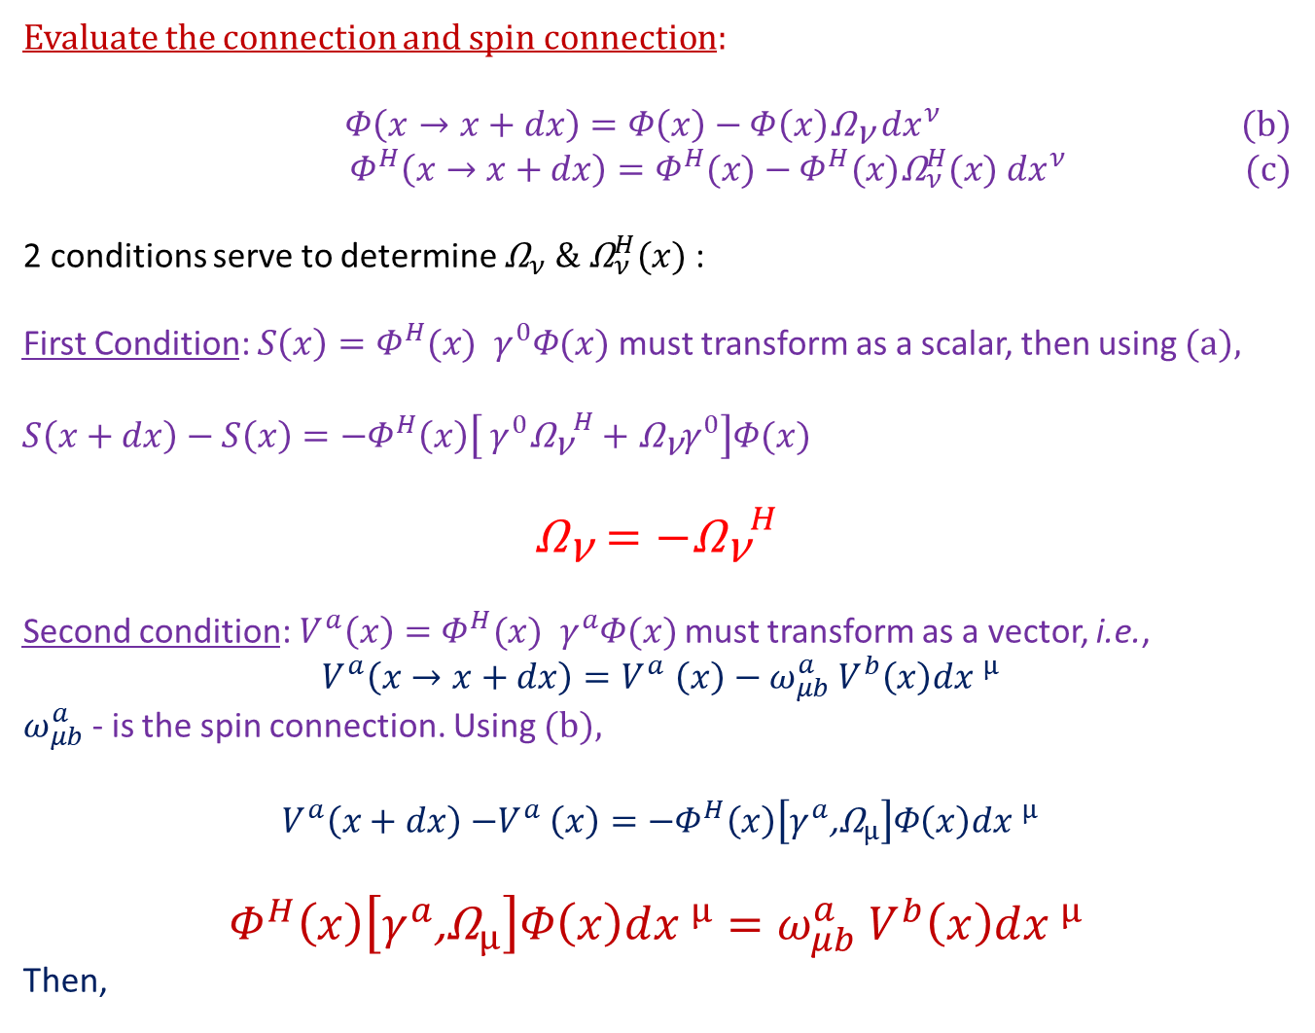
Evaluate the connection and spin connection:
$Φ\left(x→x+dx\right)=Φ\left(x\right)−{Φ\left(x\right)\text{Ω}}_{\text{ν}}{ dx}^{ν}$ (b)
$Φ^{H}\left(x→x+dx\right)=Φ^{H}(x)−Φ^{H}(x){\text{Ω}}_{ν}^{H}(x){ dx}^{ν}$ (c)
2 conditions serve to determine ${\text{Ω}}_{ν}$ $\&$ ${\text{Ω}}_{ν}^{H}(x)$ :
First Condition: ${S\left(x\right)=Φ}^{H}(x) { γ}^{0}Φ(x)$must transform as a scalar, then using (a),
$${S\left(x+dx\right)−S\left(x\right)=−Φ}^{H}\left(x\right)\left[{{ γ}^{0}{{\text{Ω}}_{\text{ν}}}^{H}+{\text{Ω}}_{\text{ν}}γ}^{0}\right]Φ(x)$$
$${\text{Ω}}_{\text{ν}}=−{{\text{Ω}}_{\text{ν}}}^{H}$$
Second condition:${{ V}^{a}\left(x\right)=Φ}^{H}(x) { γ}^{a}Φ(x)$ must transform as a vector, i.e.,
$${ V}^{a}\left(x→x+dx\right){=V}^{a}\left(x\right)−ω_{μb}^{a}{ V}^{b}\left(x\right)d{x }^{μ}$$
$ω_{μb}^{a}$ - is the spin connection. Using (b),
$${ V}^{a}\left(x+dx\right){−V}^{a}\left(x\right)=−Φ^{H}\left(x\right)\left[{γ^{a}\text{,}\text{Ω}}_{μ}\right]Φ\left(x\right)d{x }^{μ}$$
$$Φ^{H}\left(x\right)\left[{γ^{a}\text{,}\text{Ω}}_{μ}\right]Φ\left(x\right)d{x }^{μ}=ω_{μb}^{a}{ V}^{b}\left(x\right)d{x }^{μ}$$
Then,

Slide 9
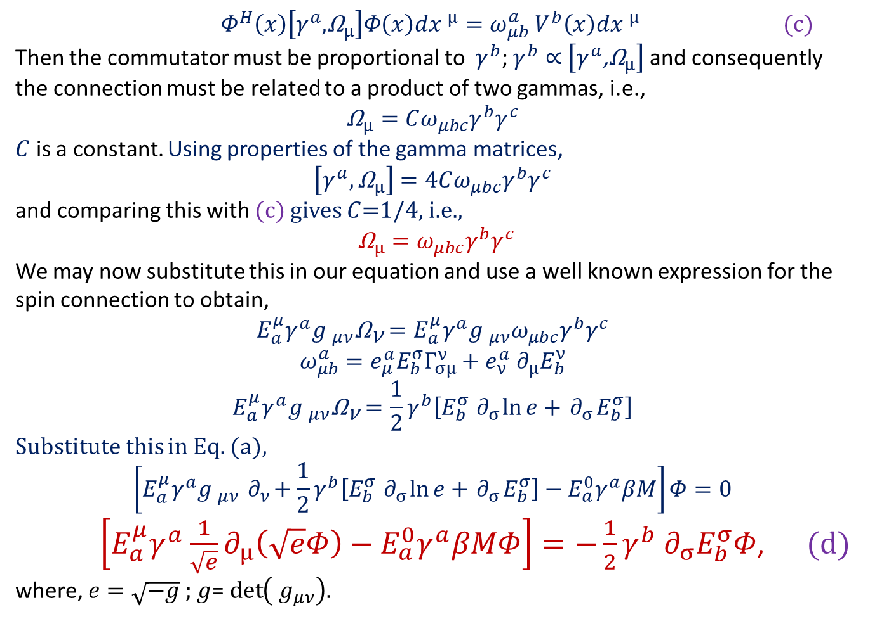
$Φ^{H}\left(x\right)\left[γ^{a},{\text{Ω}}_{μ}\right]Φ\left(x\right)d{x }^{μ}=ω_{μb}^{a}{ V}^{b}\left(x\right)d{x }^{μ}$ (c)
Then the commutator must be proportional to $γ^{b}$; $γ^{b}∝$ $\left[{γ^{a}\text{,}\text{Ω}}_{μ}\right]$ and consequently the connection must be related to a product of two gammas, i.e.,
$${\text{Ω}}_{μ}=Cω_{μbc}γ^{b}γ^{c}$$
$C$ is a constant. Using properties of the gamma matrices,
$$\left[γ^{a},{\text{Ω}}_{μ}\right]=4Cω_{μbc}γ^{b}γ^{c}$$
and comparing this with (c) gives $C$=1/4, i.e.,
${\text{Ω}}_{μ}=ω_{μbc}γ^{b}γ^{c}$
We may now substitute this in our equation and use a well known expression for the spin connection to obtain,
$${E_{a}^{μ}γ^{a}g }_{μν}{\text{Ω}}_{\text{ν}}={E_{a}^{μ}γ^{a}g }_{μν}ω_{μbc}γ^{b}γ^{c}$$
$$ω_{μb}^{a}=e_{μ}^{a}E_{b}^{σ}Γ_{σμ}^{ν}+e_{ν}^{a}{ ∂}_{μ}E_{b}^{ν}$$
$${E_{a}^{μ}γ^{a}g }_{μν}{\text{Ω}}_{\text{ν}}=\frac{1}{2}γ^{b}\left[E_{b}^{σ}{ ∂}_{σ}\ln{e}+{ ∂}_{σ}E_{b}^{σ}\right]$$
Substitute this in Eq. (a),
$$\left[{E_{a}^{μ}γ^{a}g }_{μν}{ ∂}_{ν}+\frac{1}{2}γ^{b}\left[E_{b}^{σ}{ ∂}_{σ}\ln{e}+{ ∂}_{σ}E_{b}^{σ}\right]−E_{a}^{0}γ^{a}βM\right]Φ=0$$
$\left[E_{a}^{μ}γ^{a}{\frac{1}{\sqrt{e}}∂}_{μ}\left(\sqrt{e}Φ\right)−E_{a}^{0}γ^{a}βMΦ\right]=−\frac{1}{2}γ^{b}{ ∂}_{σ}E_{b}^{σ}Φ$, (d)
where, $e=\sqrt{−g}$ ; $g$= $\det\left({ g}_{μν}\right).$

Slide 10
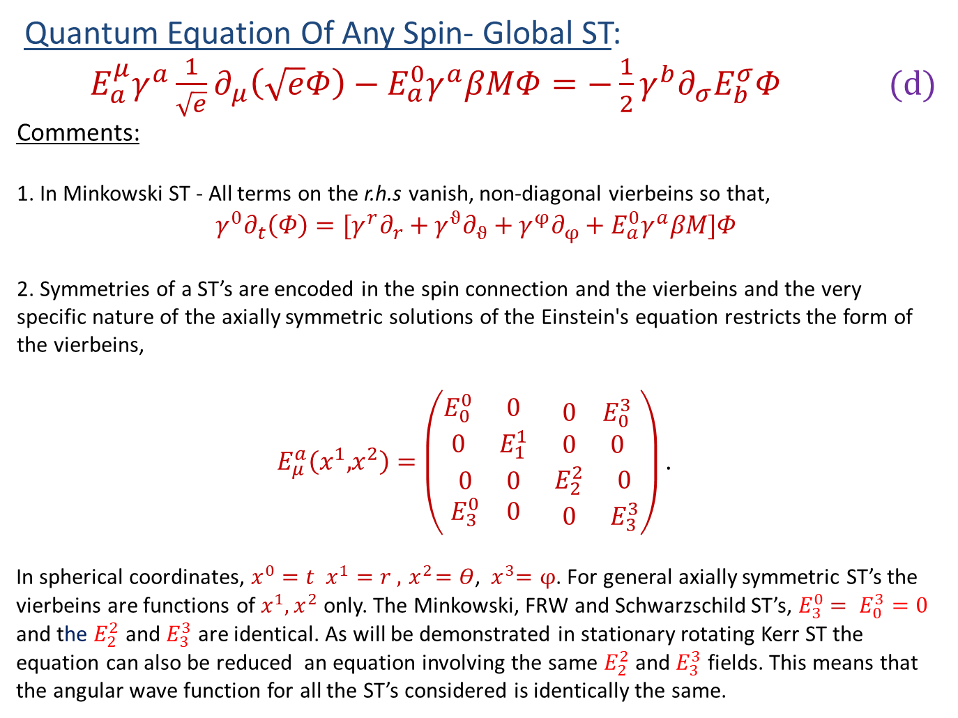
Quantum Equation Of Any Spin- Global ST:
$E_{a}^{μ}γ^{a}{\frac{1}{\sqrt{e}}∂}_{μ}\left(\sqrt{e}Φ\right)−E_{a}^{0}γ^{a}βMΦ=−\frac{1}{2}γ^{b}∂_{σ}E_{b}^{σ}Φ$ (d)
Comments:
1. In Minkowski ST - All terms on the r.h.s vanish, non-diagonal vierbeins so that,
$$γ^{0}∂_{t}\left(Φ\right)={[γ}^{r}∂_{r}+γ^{ϑ}∂_{ϑ}+γ^{φ}∂_{φ}+E_{a}^{0}γ^{a}βM]Φ$$
2. Symmetries of a ST’s are encoded in the spin connection and the vierbeins and the very specific nature of the axially symmetric solutions of the Einstein's equation restricts the form of the vierbeins,
$E_{μ}^{a}\left(x^{1},x^{2}\right)=\left(\begin{matrix}\begin{matrix}E_{0}^{0} & 0 \\ 0 & E_{1}^{1}\end{matrix} & \begin{matrix}0 & E_{0}^{3} \\ 0 & 0\end{matrix} \\ \begin{matrix}0 & 0 \\ E_{3}^{0} & 0\end{matrix} & \begin{matrix}E_{2}^{2} & 0 \\ 0 & E_{3}^{3}\end{matrix}\end{matrix}\right)$ .
In spherical coordinates, $x^{0}=t$ $x^{1}=r ,{ x}^{2}=Θ$, ${ x}^{3}=φ$. For general axially symmetric ST’s the vierbeins are functions of $x^{1},x^{2}$ only. The Minkowski, FRW and Schwarzschild ST’s, $E_{3}^{0}$ $= E_{0}^{3}=0$ and the $E_{2}^{2}$ and $E_{3}^{3}$ are identical. As will be demonstrated in stationary rotating Kerr ST the equation can also be reduced an equation involving the same $E_{2}^{2}$ and $E_{3}^{3}$ fields. This means that the angular wave function for all the ST’s considered is identically the same.

Slide 11
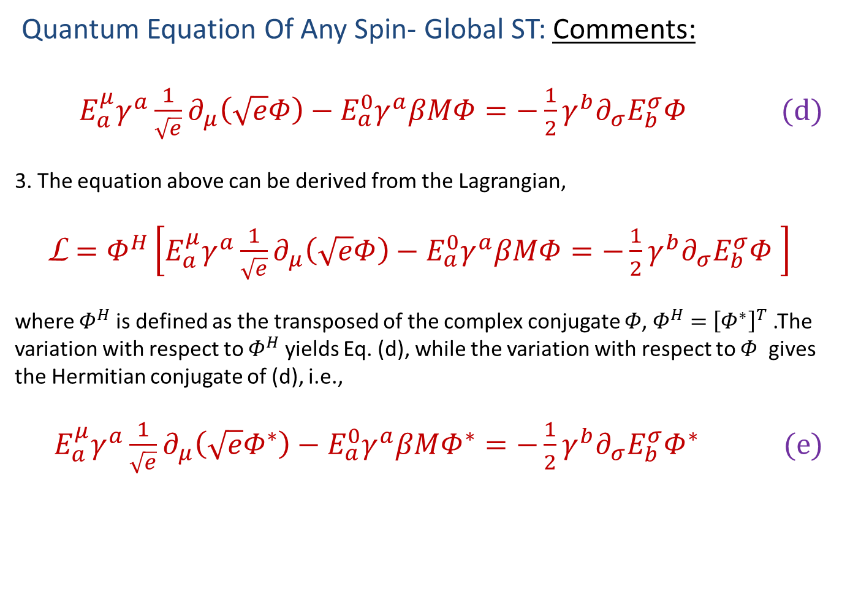
Quantum Equation Of Any Spin- Global ST: Comments:
$E_{a}^{μ}γ^{a}{\frac{1}{\sqrt{e}}∂}_{μ}\left(\sqrt{e}Φ\right)−E_{a}^{0}γ^{a}βMΦ=−\frac{1}{2}γ^{b}∂_{σ}E_{b}^{σ}Φ$ (d)
3. The equation above can be derived from the Lagrangian,
$\text{L}$ $=Φ^{H}\left[E_{a}^{μ}γ^{a}{\frac{1}{\sqrt{e}}∂}_{μ}\left(\sqrt{e}Φ\right)−E_{a}^{0}γ^{a}βMΦ=−\frac{1}{2}γ^{b}∂_{σ}E_{b}^{σ}Φ \right]$
where $Φ^{H}$ is defined as the transposed of the complex conjugate $Φ$, $Φ^{H}=$ ${\left[Φ^{∗}\right]}^{T}$ .The variation with respect to $Φ^{H}$ yields Eq. (d), while the variation with respect to $Φ$ gives the Hermitian conjugate of (d), i.e.,
$E_{a}^{μ}γ^{a}{\frac{1}{\sqrt{e}}∂}_{μ}\left(\sqrt{e}Φ^{∗}\right)−E_{a}^{0}γ^{a}βMΦ^{∗}=−\frac{1}{2}γ^{b}∂_{σ}E_{b}^{σ}Φ^{∗}$ (e)

Slide 12
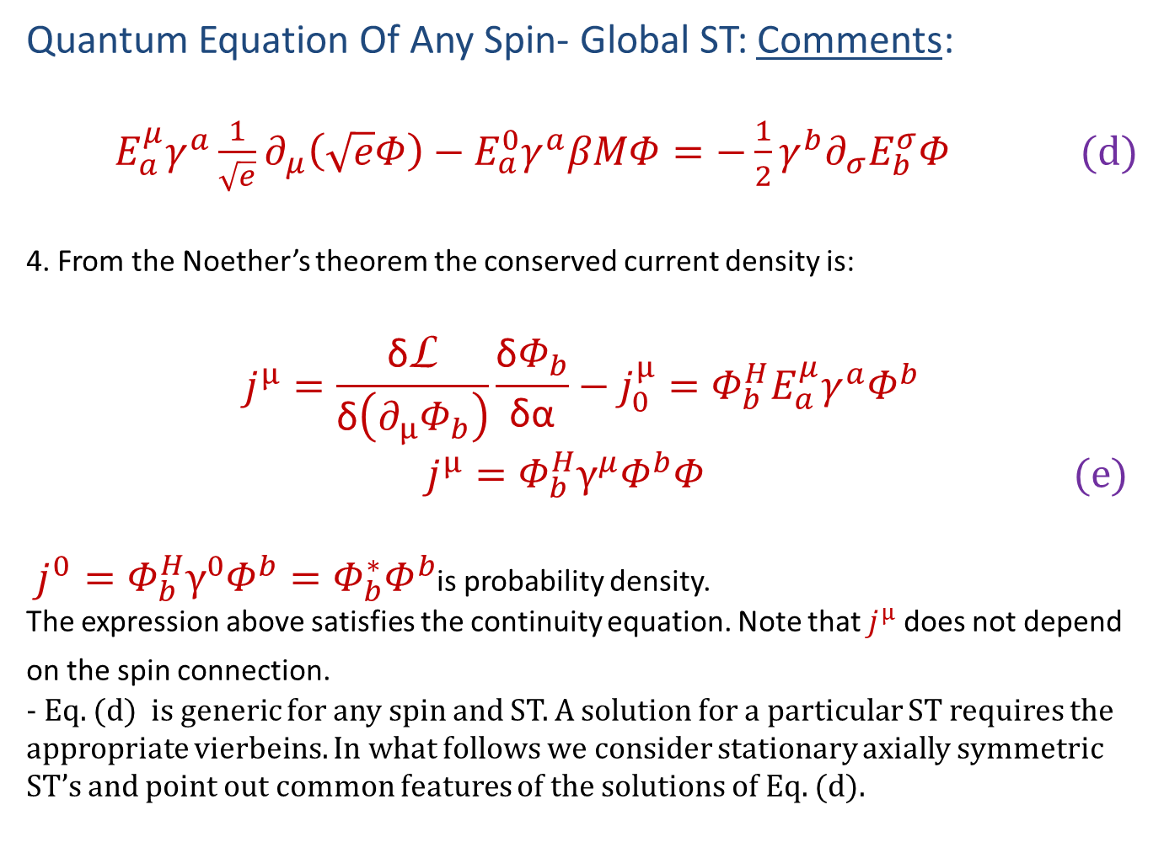
Quantum Equation Of Any Spin- Global ST: Comments:
$E_{a}^{μ}γ^{a}{\frac{1}{\sqrt{e}}∂}_{μ}\left(\sqrt{e}Φ\right)−E_{a}^{0}γ^{a}βMΦ=−\frac{1}{2}γ^{b}∂_{σ}E_{b}^{σ}Φ$ (d)
4. From the Noether’s theorem the conserved current density is:
$$j^{μ}=\frac{\text{δ}\text{L}}{\text{δ}\left(∂_{μ}Φ_{b}\right)}\frac{\text{δ}Φ_{b}}{\text{δα}}−j_{0}^{μ}=Φ_{b}^{H}E_{a}^{μ}γ^{a}Φ^{b}$$
$j^{μ}=Φ_{b}^{H}γ^{μ}Φ^{b}Φ$ (e)
$j^{0}=Φ_{b}^{H}γ^{0}Φ^{b}=Φ_{b}^{∗}Φ^{b}$is probability density.
The expression above satisfies the continuity equation. Note that $j^{μ}$ does not depend on the spin connection.
- Eq. (d) is generic for any spin and ST. A solution for a particular ST requires the appropriate vierbeins. In what follows we consider stationary axially symmetric ST’s and point out common features of the solutions of Eq. (d).

Slide 13
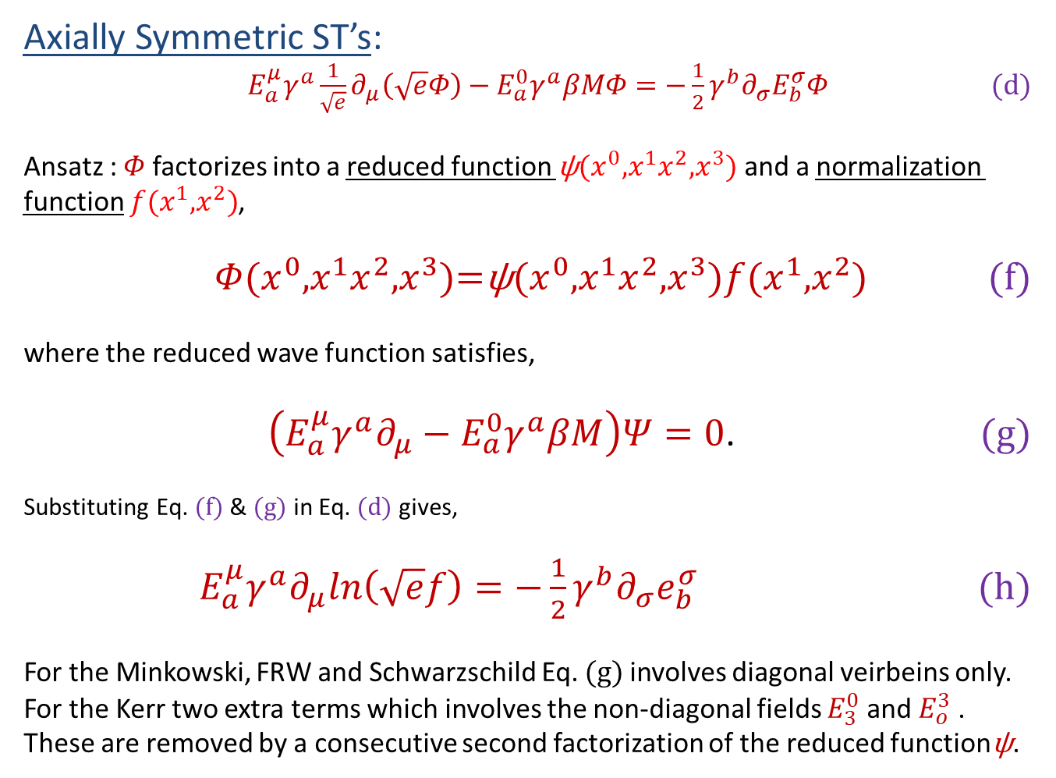
Axially Symmetric ST’s:
$E_{a}^{μ}γ^{a}{\frac{1}{\sqrt{e}}∂}_{μ}\left(\sqrt{e}Φ\right)−E_{a}^{0}γ^{a}βMΦ=−\frac{1}{2}γ^{b}∂_{σ}E_{b}^{σ}Φ$ (d)
Ansatz : $Φ$ factorizes into a reduced function $\text{ψ}{{({x^{0},x}^{1}x}^{2},x}^{3})$ and a normalization function $f{{(x}^{1},x}^{2})$,
$Φ{{({x^{0},x}^{1}x}^{2},x}^{3})\text{=}\text{ψ}{{({x^{0},x}^{1}x}^{2},x}^{3})f{{(x}^{1},x}^{2}$) (f)
where the reduced wave function satisfies,
$\left(E_{a}^{μ}γ^{a}∂_{μ}−E_{a}^{0}γ^{a}βM\right)Ψ=0$. (g)
Substituting Eq. (f) & (g) in Eq. (d) gives,
$E_{a}^{μ}γ^{a}∂_{μ}ln\left(\sqrt{e}f\right)=−\frac{1}{2}γ^{b}∂_{σ}e_{b}^{σ}$ (h)
For the Minkowski, FRW and Schwarzschild Eq. (g) involves diagonal veirbeins only. For the Kerr two extra terms which involves the non-diagonal fields $E_{3}^{0}$ and $E_{o}^{3}$ . These are removed by a consecutive second factorization of the reduced function$\text{ψ}$.

Slide 14

The Normalization Function:
$E_{a}^{μ}γ^{a}∂_{μ}ln\left(\sqrt{e}f\right)=−\frac{1}{2}γ^{b}∂_{σ}e_{b}^{σ}$ (h)
Comments:
1. All complexities due to the spin connection are restricted in the expression above. The reduced wave function and likewise its solutions do not depend on the spin connection.
2. For stationary axially symmetric ST’s the normalization function $f\left(r,ϑ\right)$ does not depend neither on time nor on the azimuthal coordinate and Eq. (h) reduces to,
$∂_{μ}ln\left[\sqrt{ef}\left(r,ϑ\right)\right]=−\frac{1}{2}γ^{b}∂_{σ}e_{b}^{σ}$ b=1,2
3. For the Minkowski, FRW, Schwarzchild and the stationary rotating Kerr:
$∂_{r}ln\left[\sqrt{e}f\left(r,ϑ\right)\right]{=∂}_{ϑ}ln\left[\sqrt{e}f\left(r,ϑ\right)\right]=∂_{φ}ln\left[\sqrt{e}f\left(r,ϑ\right)\right]$ $=0$
so that,
$∂_{r}ln\left[\sqrt{e}f\left(r,ϑ\right)\right]{=−\frac{1}{2}e_{1}^{1}∂}_{r}E_{1}^{1}$; Integrable.
4. The expression above is integrable and the normalization function resumes simple analytic form as listed in the table to follow.

Slide 15
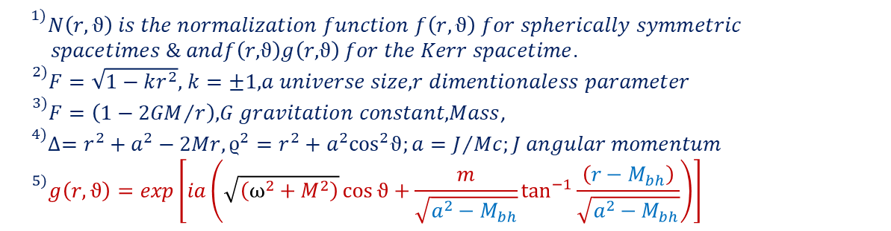
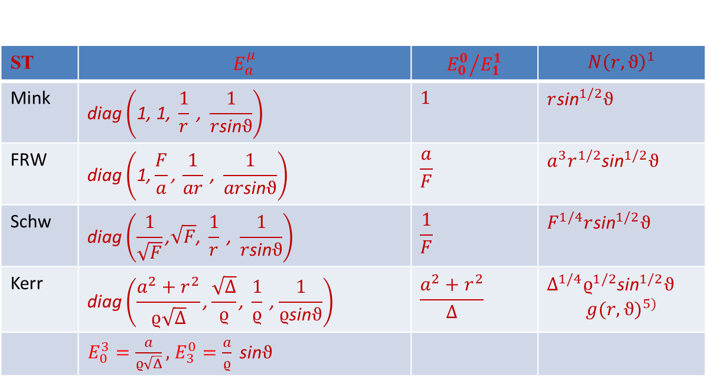
Table 1: The Normalization Function
ST | $$E_{a}^{μ}$$ | $${E_{0}^{0}}/{E_{1}^{1}}$$ | $${N\left(r,ϑ\right)}^{1}$$
Mink | $$\text{diag}\left(\text{1}\text{, }\text{1}\text{, }\frac{1}{r}\text{ , }\frac{1}{r\text{sin}ϑ}\right)$$ | $$1$$ | $$r{\text{sin}}^{1/2}ϑ$$
FRW | $$\text{diag}\left(\text{1}\text{,}\frac{F}{a}\text{,} \frac{1}{ar}\text{ , }\frac{1}{ar\text{sin}ϑ}\right)$$ | $$\frac{a}{F}$$ | $$a^{3}r^{1/2}{\text{sin}}^{1/2}ϑ$$
Schw | $$\text{diag}\left(\frac{1}{\sqrt{F}}\text{,}\sqrt{F}\text{, }\frac{1}{r}\text{ , }\frac{1}{r\text{sin}ϑ}\right)$$ | $$\frac{1}{F}$$ | $$F^{1/4}r{\text{sin}}^{1/2}ϑ$$
Kerr | $$\text{diag}\left(\frac{a^{2}+r^{2}}{ϱ\sqrt{Δ}}\text{,}\frac{\sqrt{Δ}}{ϱ}\text{, }\frac{1}{ϱ}\text{ ,}\frac{1}{ϱ\text{sin}ϑ}\right)$$ | $$\frac{a^{2}+r^{2}}{Δ}$$ | $$Δ^{1/4}ϱ^{1/2}{\text{sin}}^{1/2}ϑ$$ $${g(r,ϑ)}^{5)}$$
 | $E_{0}^{3}=\frac{a}{ϱ\sqrt{Δ}},$ $E_{3}^{0}=\frac{a}{ϱ} \text{sin}ϑ$
$${}^{1)}N\left(r,ϑ\right) is the normalization function f\left(r,ϑ\right) for spherically symmetric$$
$spacetimes \& andf\left(r,ϑ\right)g\left(r,ϑ\right) for the Kerr spacetime$.
${}^{2)}F=\sqrt{1−kr^{2}},$ $k=±1,a universe size, r dimentionaless parameter$
${}^{3)}F=\left(1−{2GM}/r\right), G gravitation constant, Mass$,
$${}^{4)}∆=r^{2}+a^{2}−2Mr,{ϱ^{2}=r}^{2}+a^{2}\cos^{2}ϑ;a=J/{Mc;J angular momentum}$$
$${}^{5)}g\left(r,ϑ\right)=exp\left[ia\left(\sqrt{\left(ω^{2}+M^{2}\right)}\cos{ϑ}+\frac{m}{\sqrt{{a^{2}−M}_{bh}}}\tan^{−1}{\frac{\left({r−M}_{bh}\right)}{\sqrt{{a^{2}−M}_{bh}}}}\right)\right]$$

Slide 16
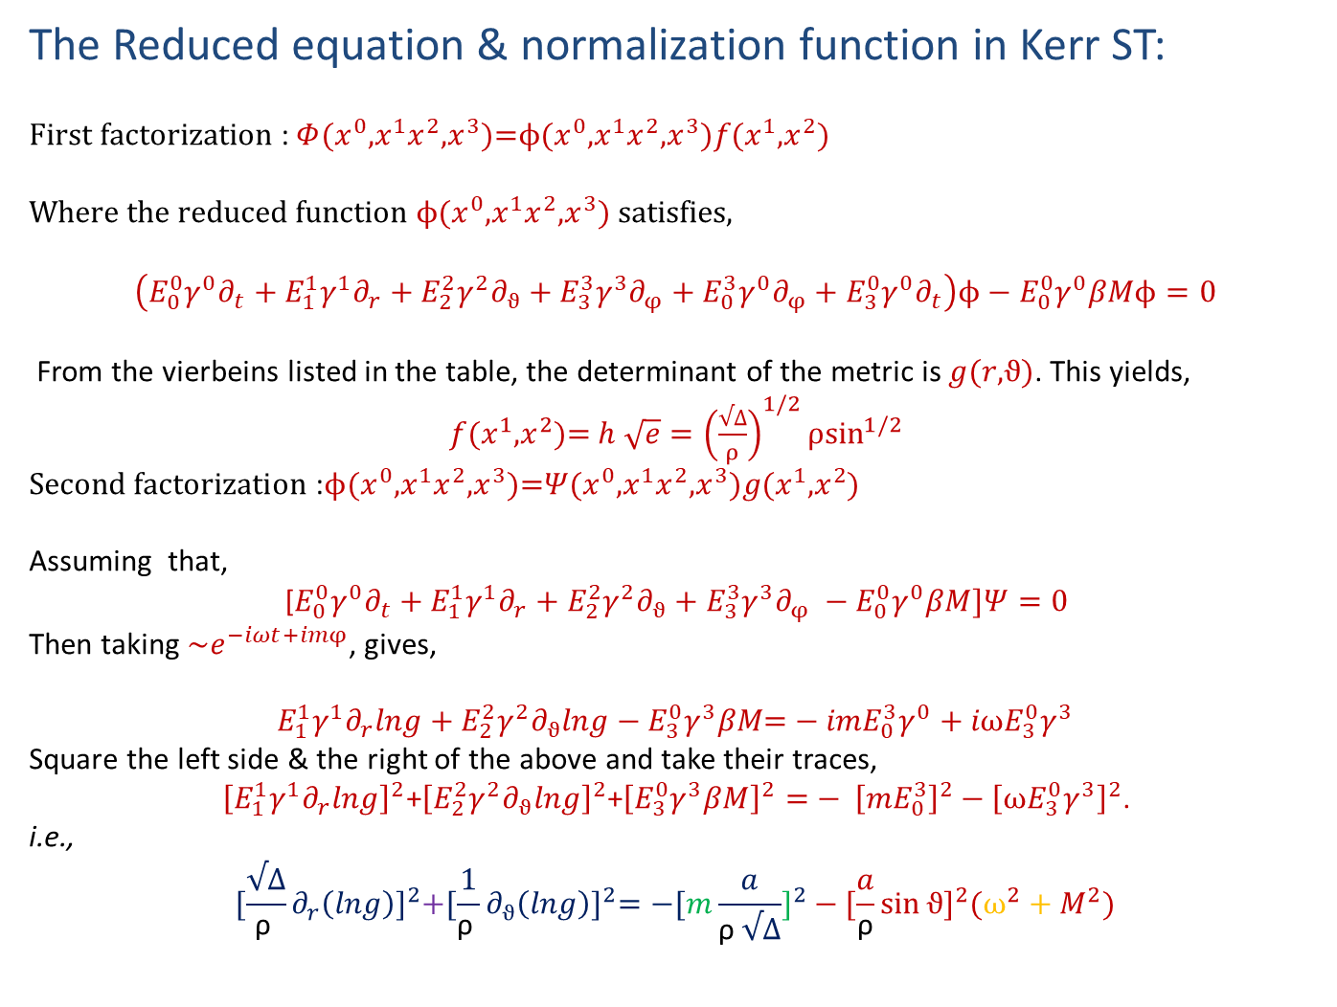
The Reduced equation & normalization function in Kerr ST:
$First factorization$ : $Φ{{({x^{0},x}^{1}x}^{2},x}^{3})\text{=}ϕ{{({x^{0},x}^{1}x}^{2},x}^{3})f{{(x}^{1},x}^{2}$)
Where the reduced function $ϕ{{({x^{0},x}^{1}x}^{2},x}^{3})$ satisfies,
$$\left(E_{0}^{0}γ^{0}∂_{t}+E_{1}^{1}γ^{1}∂_{r}+E_{2}^{2}γ^{2}∂_{ϑ}+E_{3}^{3}γ^{3}∂_{φ}+E_{0}^{3}γ^{0}∂_{φ}+E_{3}^{0}γ^{0}∂_{t}\right)ϕ−E_{0}^{0}γ^{0}βMϕ=0$$
From the vierbeins listed in the table, the determinant of the metric is $g(r,ϑ)$. This yields,
$f{{(x}^{1},x}^{2}$)= $h \sqrt{e}={\left(\frac{√∆}{ρ}\right)}^{1/2}ρ\sin^{1/2}$
$Second factorization$ :$ϕ{{({x^{0},x}^{1}x}^{2},x}^{3})\text{=}Ψ{{({x^{0},x}^{1}x}^{2},x}^{3})g{{(x}^{1},x}^{2}$)
Assuming that,
[$E_{0}^{0}γ^{0}∂_{t}+E_{1}^{1}γ^{1}∂_{r}+E_{2}^{2}γ^{2}∂_{ϑ}+E_{3}^{3}γ^{3}∂_{φ} −E_{0}^{0}γ^{0}βM]Ψ=0$
Then taking $\sim e^{−iωt+imφ}$, gives,
$$E_{1}^{1}γ^{1}∂_{r}lng+E_{2}^{2}γ^{2}∂_{ϑ}lng−E_{3}^{0}γ^{3}βM\text{=}−{imE}_{0}^{3}γ^{0}+{iωE}_{3}^{0}γ^{3}$$
Square the left side & the right of the above and take their traces,
${\left[E_{1}^{1}γ^{1}∂_{r}lng\right]}^{2}$+${\left[E_{2}^{2}γ^{2}∂_{ϑ}lng\right]}^{2}$+${\left[E_{3}^{0}γ^{3}βM\right]}^{2}$ $\text{=}− {\left[{mE}_{0}^{3}\right]}^{2}$ $− {\left[{ωE}_{3}^{0}γ^{3}\right]}^{2}$.
i.e.,
$${[\frac{√∆}{\text{ρ} }∂_{r}\left(lng\right)]}^{2}\text{+}{[{\frac{1}{\text{ρ} }∂}_{ϑ}\left(lng\right)]}^{2}=−[{m\frac{a}{\text{ρ} √∆}]}^{2}−{[\frac{a}{\text{ρ}}\sin{ϑ}]}^{2}(ω^{2}+M^{2})$$

Slide 17
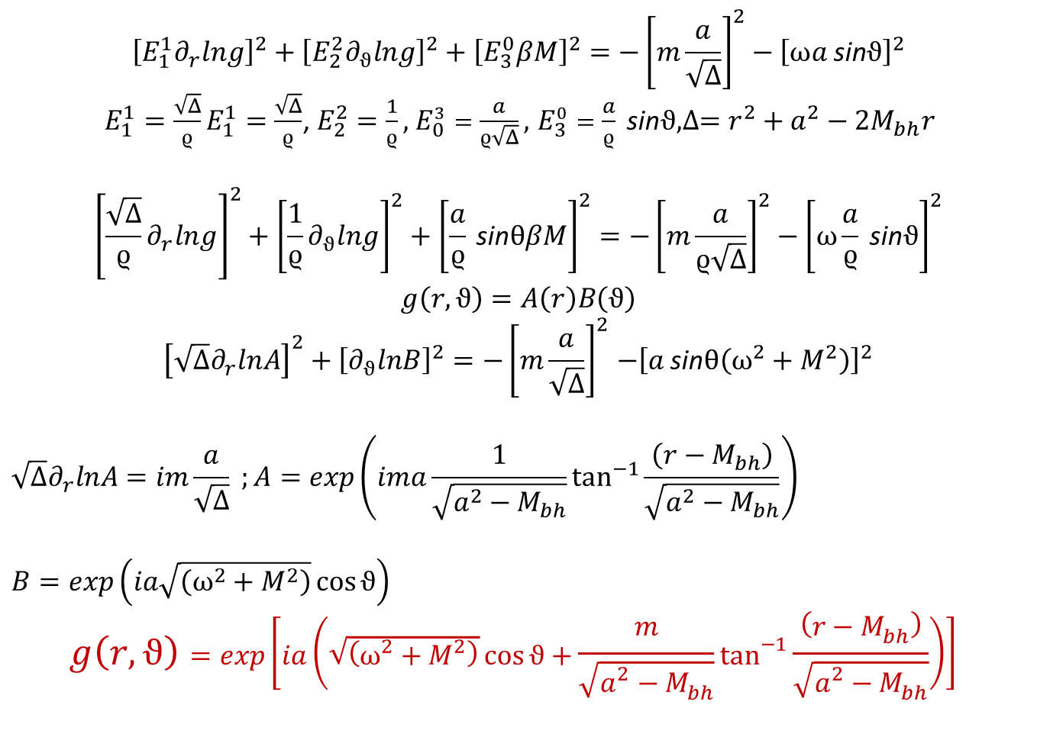
$${\left[E_{1}^{1}∂_{r}lng\right]}^{2}+{\left[E_{2}^{2}∂_{ϑ}lng\right]}^{2}+{\left[E_{3}^{0}βM\right]}^{2}={−\left[m\frac{a}{\sqrt{Δ}}\right]}^{2}−{\left[ωa \text{sin}ϑ\right]}^{2}$$
$E_{1}^{1}=\frac{\sqrt{Δ}}{ϱ}E_{1}^{1}=\frac{\sqrt{Δ}}{ϱ}$, $E_{2}^{2}=\frac{1}{ϱ},{ E}_{0}^{3}=\frac{a}{ϱ\sqrt{Δ}},$ $E_{3}^{0}=\frac{a}{ϱ} \text{sin}ϑ, ∆=r^{2}+a^{2}−2M_{bh}r$
$${\left[\frac{\sqrt{Δ}}{ϱ}∂_{r}lng\right]}^{2}+{\left[\frac{1}{ϱ}∂_{ϑ}lng\right]}^{2}+{\left[\frac{a}{ϱ} \text{sin}θβM\right]}^{2}={−\left[m\frac{a}{ϱ\sqrt{Δ}}\right]}^{2}−{\left[ω\frac{a}{ϱ} \text{sin}ϑ\right]}^{2}$$
$$g\left(r,ϑ\right)=A\left(r\right)B\left(ϑ\right)$$
$${\left[\sqrt{Δ}∂_{r}lnA\right]}^{2}+{\left[∂_{ϑ}lnB\right]}^{2}{=−\left[m\frac{a}{\sqrt{Δ}}\right]}^{2}−{\left[a \text{sin}θ\left(ω^{2}+M^{2}\right)\right]}^{2}$$
$$\sqrt{Δ}∂_{r}lnA=im\frac{a}{\sqrt{Δ}} ;A=exp\left(ima\frac{1}{\sqrt{{a^{2}−M}_{bh}}}\tan^{−1}{\frac{\left({r−M}_{bh}\right)}{\sqrt{{a^{2}−M}_{bh}}}}\right)$$
$$B=exp\left(ia\sqrt{\left(ω^{2}+M^{2}\right)}\cos{ϑ}\right)$$
$$g\left(r,ϑ\right)=exp\left[ia\left(\sqrt{\left(ω^{2}+M^{2}\right)}\cos{ϑ}+\frac{m}{\sqrt{{a^{2}−M}_{bh}}}\tan^{−1}{\frac{\left({r−M}_{bh}\right)}{\sqrt{{a^{2}−M}_{bh}}}}\right)\right]⁡$$

Slide 18
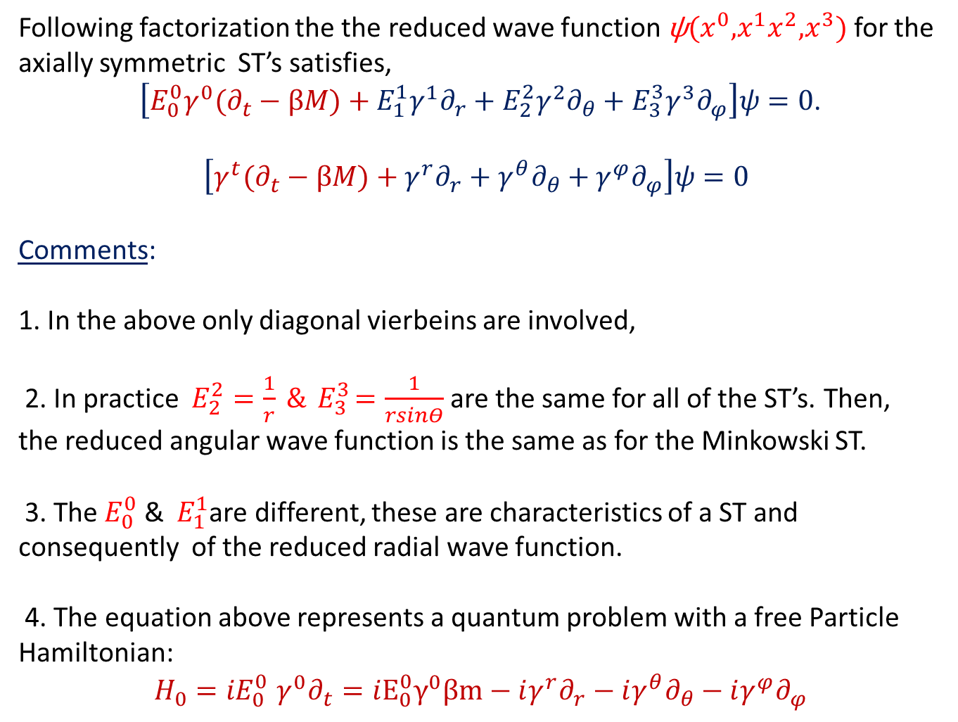
Following factorization the the reduced wave function $\text{ψ}{{({x^{0},x}^{1}x}^{2},x}^{3})$ for the axially symmetric ST’s satisfies,
$\left[{{E_{0}^{0}γ}^{0}(∂}_{t}−βM)+{{E_{1}^{1}γ}^{1}∂}_{r}+{{E_{2}^{2}γ}^{2}∂}_{θ}+{{E_{3}^{3}γ}^{3}∂}_{φ}\right]ψ=0$.
$$\left[{γ^{t}(∂}_{t}−βM)+{γ^{r}∂}_{r}+{γ^{θ}∂}_{θ}+{γ^{φ}∂}_{φ}\right]ψ=0$$
Comments:
1. In the above only diagonal vierbeins are involved,
2. In practice $E_{2}^{2}=\frac{1}{r} \&{ E}_{3}^{3}=\frac{1}{rsinΘ}$ are the same for all of the ST’s. Then, the reduced angular wave function is the same as for the Minkowski ST.
3. The${ E}_{0}^{0}$ & ${ E}_{1}^{1}$are different, these are characteristics of a ST and consequently of the reduced radial wave function.
4. The equation above represents a quantum problem with a free Particle Hamiltonian:
$H_{0}{{=iE}_{0}^{0}γ}^{0}∂_{t}=i{E_{0}^{0}γ}^{0}βm−i{γ^{r}∂}_{r}−i{γ^{θ}∂}_{θ}−i{γ^{φ}∂}_{φ}$

Slide 19
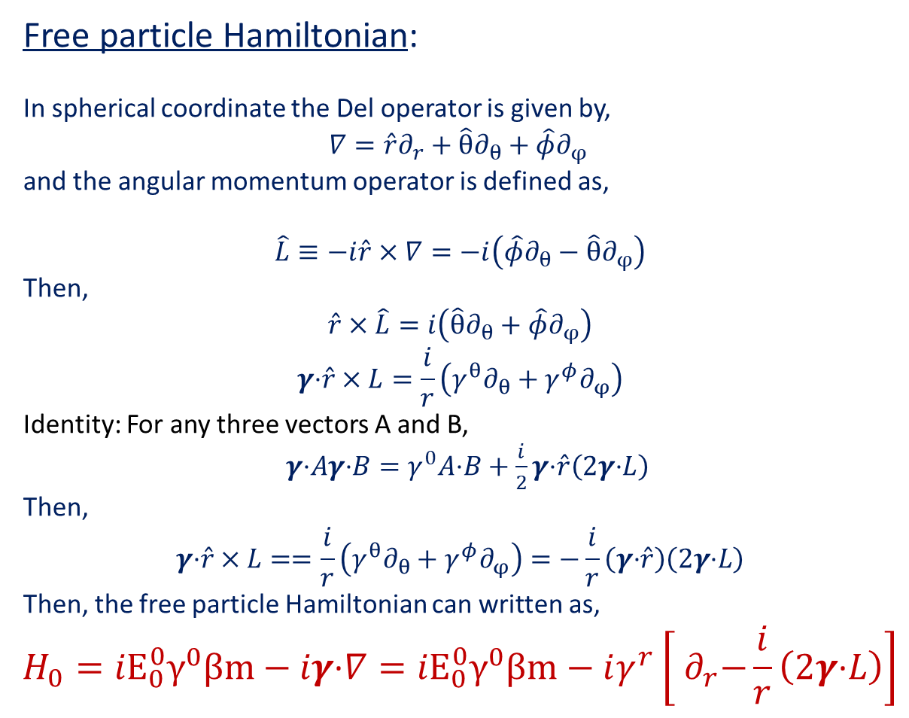
Free particle Hamiltonian:
In spherical coordinate the Del operator is given by,
$∇=\hat{r}∂_{r}+{\hat{θ}∂}_{θ}+{\hat{φ}∂}_{φ}$
and the angular momentum operator is defined as,
$$\hat{L}≡−i\hat{r}×∇=−i\left({\hat{φ}∂}_{θ}−{\hat{θ}∂}_{φ}\right)$$
Then,
$$\hat{r}×\hat{L}=i\left({\hat{θ}∂}_{θ}+{\hat{φ}∂}_{φ}\right)$$
$$γ\text{·}\hat{r}×L=\frac{i}{r}\left({γ^{θ}∂}_{θ}+{γ^{φ}∂}_{φ}\right)$$
Identity: For any three vectors A and B,
$γ\text{·}Aγ\text{·}B=γ^{0}A\text{·}B+\frac{i}{2}γ\text{·}\hat{r}\left(2γ\text{·}L\right)$
Then,
$$γ\text{·}\hat{r}×L==\frac{i}{r}\left({γ^{θ}∂}_{θ}+{γ^{φ}∂}_{φ}\right)=−\frac{i}{r}\left(γ\text{·}\hat{r}\right)\left(2γ\text{·}L\right)$$
Then, the free particle Hamiltonian can written as,
$$H_{0}={{iE}_{0}^{0}γ}^{0}βm−iγ\text{·}∇={{iE}_{0}^{0}γ}^{0}βm−iγ^{r}\left[{ ∂}_{r}−\frac{i}{r}\left(2γ\text{·}L\right)\right]$$

Slide 20
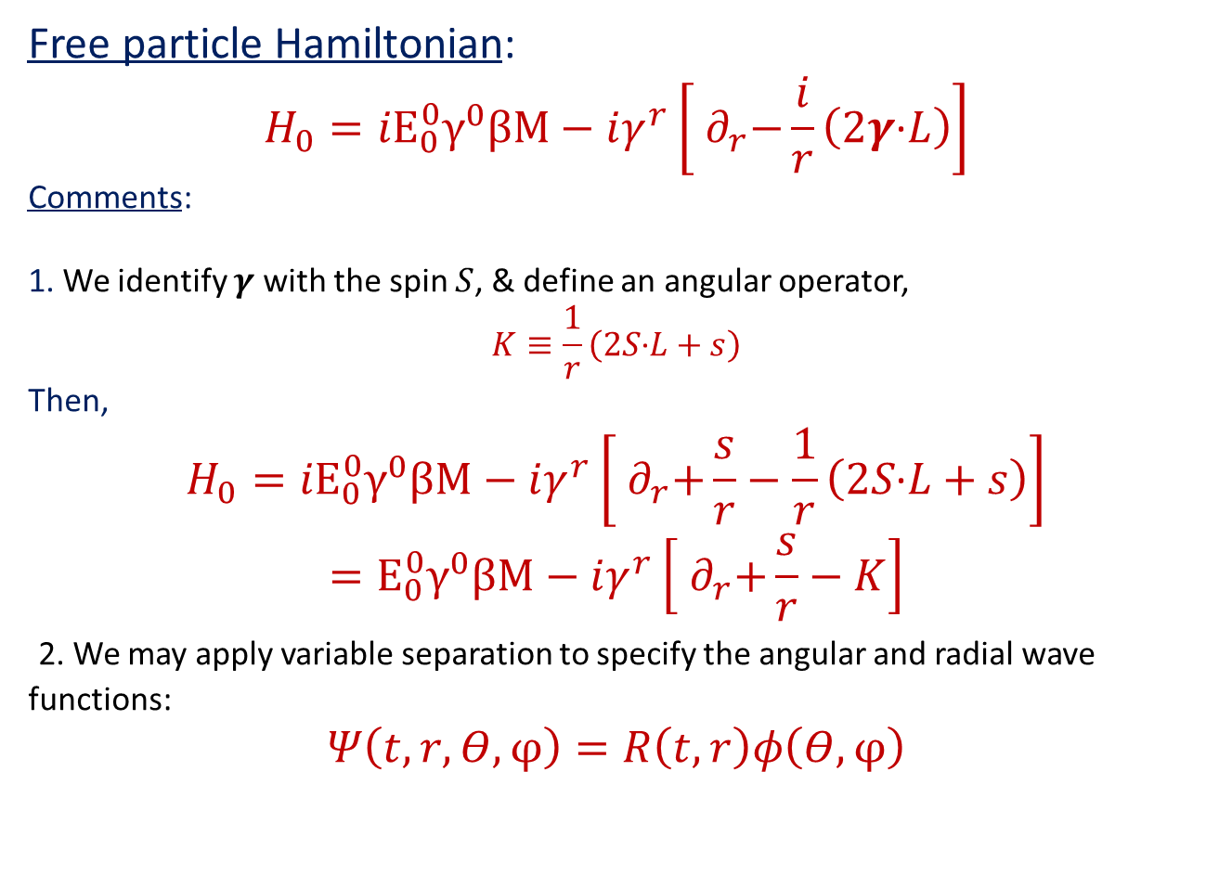
Free particle Hamiltonian:
$$H_{0}={{iE}_{0}^{0}γ}^{0}βM−iγ^{r}\left[{ ∂}_{r}−\frac{i}{r}\left(2γ\text{·}L\right)\right]$$
Comments:
1. We identify $γ$ with the spin $S$, & define an angular operator,
$$K≡\frac{1}{r}\left(2S\text{·}L+s\right)$$
Then,
$$H_{0}={{iE}_{0}^{0}γ}^{0}βM−iγ^{r}\left[{ ∂}_{r}+\frac{s}{r}−\frac{1}{r}\left(2S\text{·}L+s\right)\right]$$
$$={E_{0}^{0}γ}^{0}βM−iγ^{r}\left[{ ∂}_{r}+\frac{s}{r}−K\right]$$
2. We may apply variable separation to specify the angular and radial wave functions:
$$Ψ\left(t,r, Θ,φ\right)=R\left(t,r\right)φ\left(Θ,φ\right)$$

Slide 21
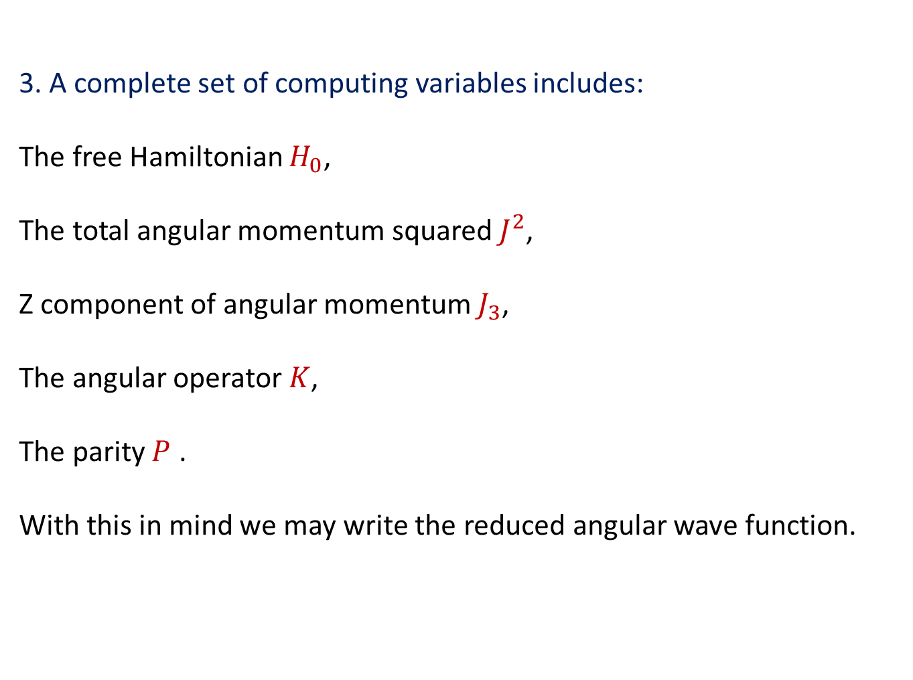
3. A complete set of computing variables includes:
The free Hamiltonian $H_{0}$,
The total angular momentum squared $J^{2}$,
Z component of angular momentum $J_{3}$,
The angular operator $K$,
The parity $P$ .
With this in mind we may write the reduced angular wave function.

Slide 22
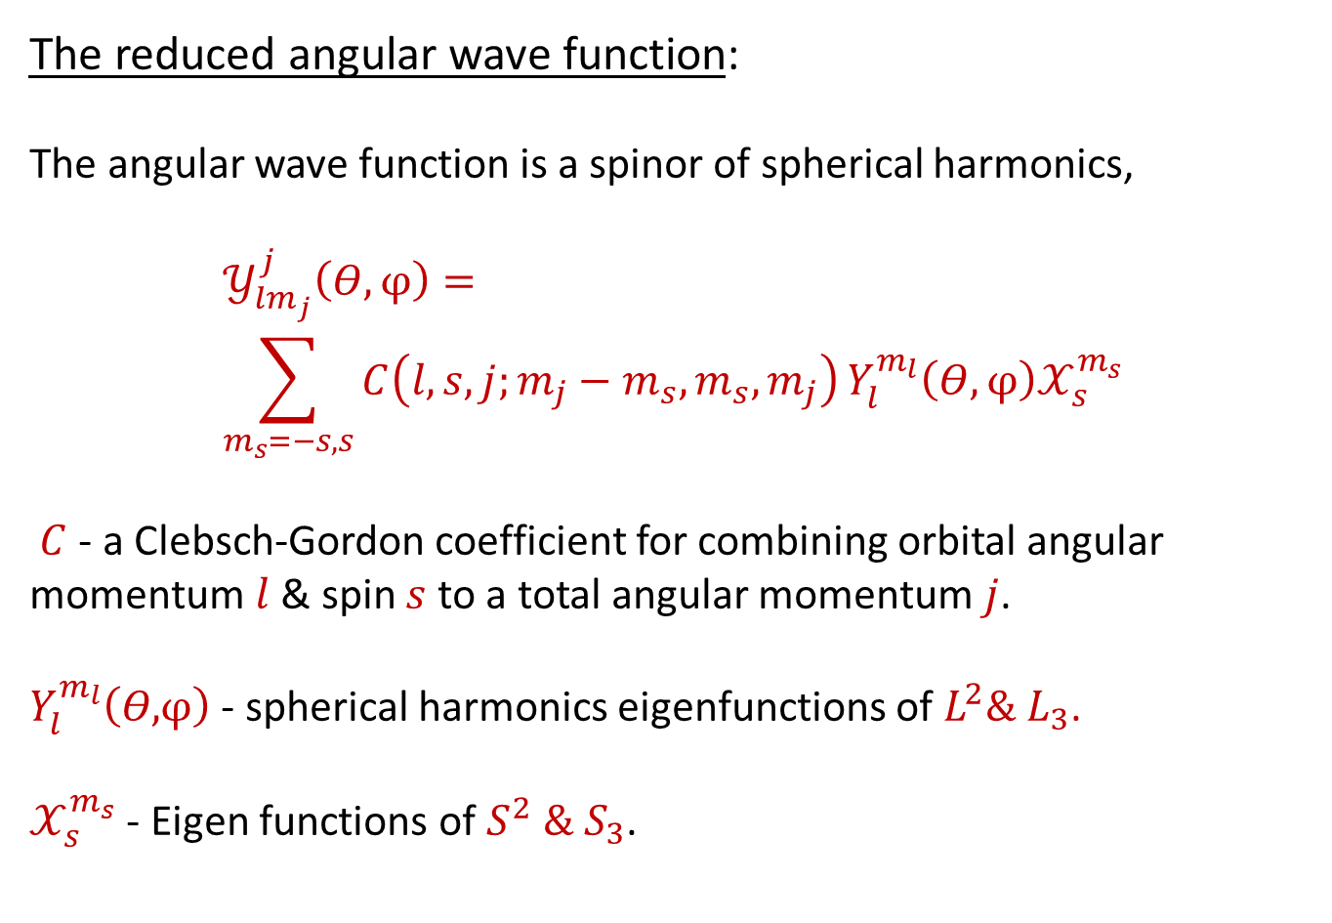
The reduced angular wave function:
The angular wave function is a spinor of spherical harmonics,
$$𝒴_{lm_{j}}^{j}\left(Θ,φ\right)= \\ \sum_{m_{s}=−s,s}{C\left(l,s,j;m_{j}−m_{s},m_{s},m_{j}\right)}Y_{l}^{m_{l}}\left(Θ,φ\right)𝒳_{s}^{m_{s}}$$
$C$- a Clebsch-Gordon coefficient for combining orbital angular momentum $l$ & spin $s$ to a total angular momentum $j$.
$Y_{l}^{m_{l}}\left(Θ,φ\right)$ - spherical harmonics eigenfunctions of $L^{2}\& L_{3}$.
$𝒳_{s}^{m_{s}}$ - Eigen functions of $S^{2} \& S_{3}$.

Slide 23
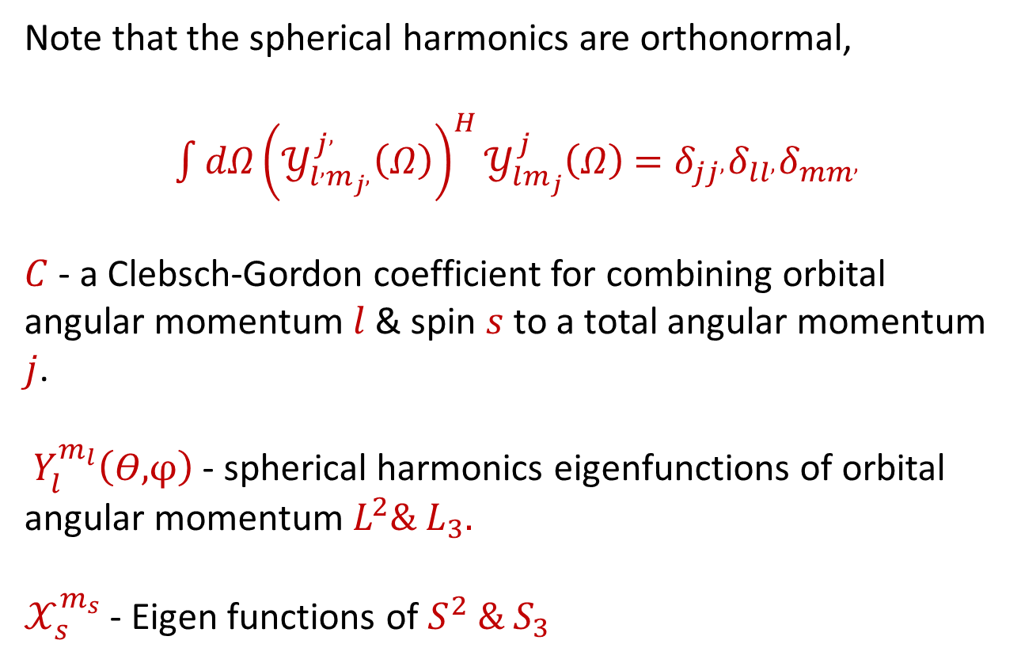
Note that the spherical harmonics are orthonormal,
$\int{{dΩ{\left(𝒴_{l^{,}m_{j^{,}}}^{j^{,}}\left(Ω\right)\right)}^{H}𝒴}_{lm_{j}}^{j}\left(Ω\right)}$ $=δ_{jj^{,}}δ_{ll^{,}}δ_{mm^{,}}$
$C$- a Clebsch-Gordon coefficient for combining orbital angular momentum $l$ & spin $s$ to a total angular momentum $j$.
$Y_{l}^{m_{l}}\left(Θ,φ\right)$ - spherical harmonics eigenfunctions of orbital angular momentum $L^{2}\& L_{3}.$
$𝒳_{s}^{m_{s}}$ - Eigen functions of $S^{2} \& S_{3}$

Slide 24
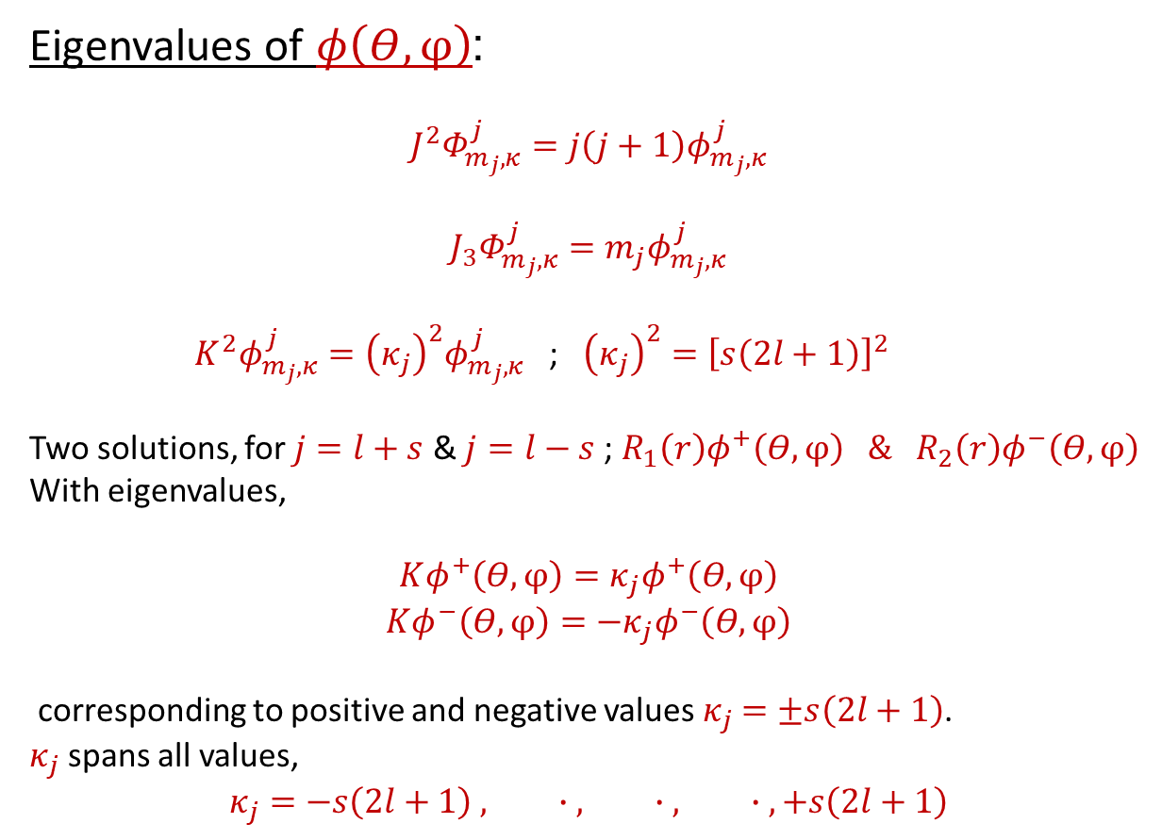
Eigenvalues of $φ\left(Θ,φ\right)$:
$${J^{2}Φ}_{m_{j},κ}^{j}=j\left(j+1\right)φ_{m_{j},κ}^{j}$$
$${J_{3}Φ}_{m_{j},κ}^{j}=m_{j}φ_{m_{j},κ}^{j}$$
${{ K}^{2}φ}_{m_{j},κ}^{j}={\left(κ_{j}\right)}^{2}φ_{m_{j},κ}^{j}$ ; ${\left(κ_{j}\right)}^{2}={\left[s\left(2l+1\right)\right]}^{2}$
Two solutions, for $j=l+s$ & $j=l−s$ ; $R_{1}\left(r\right)φ^{+}\left(Θ,φ\right) \& R_{2}\left(r\right)φ^{−}\left(Θ,φ\right)$
With eigenvalues,
$$Kφ^{+}\left(Θ,φ\right)=κ_{j}φ^{+}\left(Θ,φ\right)$$
$$Kφ^{−}\left(Θ,φ\right)={−κ}_{j}φ^{−}\left(Θ,φ\right)$$
corresponding to positive and negative values $κ_{j}$ $=±s\left(2l+1\right)$.
$κ_{j}$ spans all values,
$$κ_{j}=−s\left(2l+1\right) , ∙ , ∙ , ∙ ,+s\left(2l+1\right)$$

Slide 25
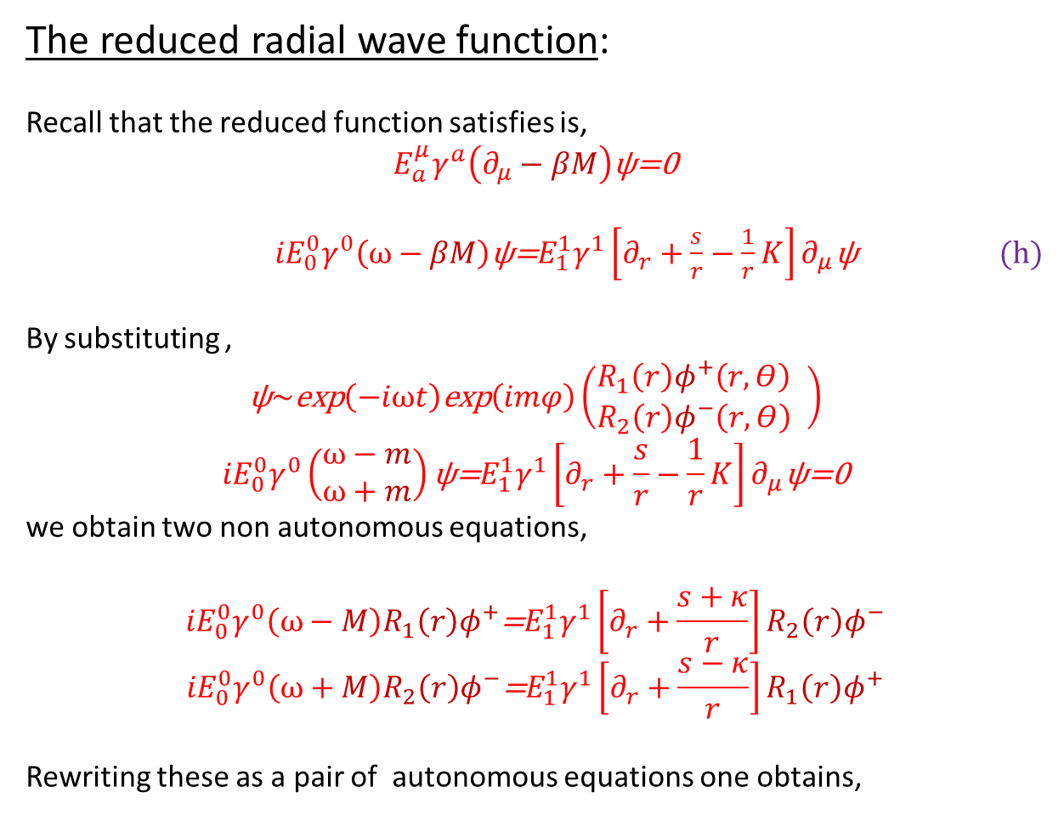
The reduced radial wave function:
Recall that the reduced function satisfies is,
$$E_{a}^{μ}γ^{a}\left(∂_{μ}−βM\right)\text{ψ}\text{=}\text{0}$$
${iE}_{0}^{0}γ^{0}\left(ω−βM\right)\text{ψ}\text{=}E_{1}^{1}γ^{1}{\left[∂_{r}+\frac{s}{r}−\frac{1}{r}K\right]∂}_{μ}\text{ψ}$ (h)
By substituting ,
$$\text{ψ}\sim \text{exp}\left(−iωt\right)\text{exp}\left(imφ\right)\left(\begin{matrix}R_{1}\left(r\right)φ^{+}\left(r,Θ\right) \\ R_{2}\left(r\right)φ^{−}\left(r,Θ\right)\end{matrix} \right)$$
$${iE}_{0}^{0}γ^{0}\left(\begin{matrix}ω−m \\ ω+m\end{matrix}\right)\text{ψ}\text{=}E_{1}^{1}γ^{1}{\left[∂_{r}+\frac{s}{r}−\frac{1}{r}K\right]∂}_{μ}\text{ψ}\text{=}\text{0}$$
we obtain two non autonomous equations,
$${iE}_{0}^{0}γ^{0}\left(ω−M\right)R_{1}\left(r\right)φ^{+}\text{=}E_{1}^{1}γ^{1}\left[∂_{r}+\frac{s+κ}{r}\right]R_{2}\left(r\right)φ^{−} \\ {iE}_{0}^{0}γ^{0}\left(ω+M\right)R_{2}\left(r\right)φ^{−}\text{=}E_{1}^{1}γ^{1}\left[∂_{r}+\frac{s−κ}{r}\right]R_{1}\left(r\right)φ^{+}$$
Rewriting these as a pair of autonomous equations one obtains,

Slide 26
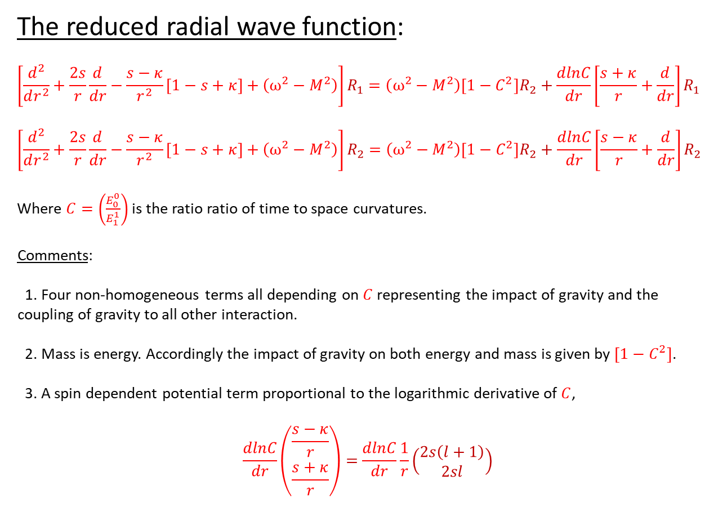
The reduced radial wave function:
$$\left[\frac{d^{2}}{dr^{2}}+\frac{2s}{r}\frac{d}{dr}−\frac{s−κ}{r^{2}}\left[1−s+κ\right]+\left(ω^{2}−M^{2}\right)\right]R_{1}=\left(ω^{2}−M^{2}\right)\left[1−C^{2}\right]R_{2}+\frac{dlnC}{dr}\left[\frac{s+κ}{r}+\frac{d}{dr}\right]R_{1}$$
$$\left[\frac{d^{2}}{dr^{2}}+\frac{2s}{r}\frac{d}{dr}−\frac{s−κ}{r^{2}}\left[1−s+κ\right]+\left(ω^{2}−M^{2}\right)\right]R_{2}=\left(ω^{2}−M^{2}\right)\left[1−C^{2}\right]R_{2}+\frac{dlnC}{dr}\left[\frac{s−κ}{r}+\frac{d}{dr}\right]R_{2}$$
Where $C=\left(\frac{E_{0}^{0}}{E_{1}^{1}}\right)$ is the ratio ratio of time to space curvatures.
Comments:
1. Four non-homogeneous terms all depending on $C$ representing the impact of gravity and the coupling of gravity to all other interaction.
2. Mass is energy. Accordingly the impact of gravity on both energy and mass is given by $\left[1−C^{2}\right]$.
3. A spin dependent potential term proportional to the logarithmic derivative of $C$,
$$\frac{dlnC}{dr}\left(\begin{aligned}\frac{s−κ}{r} \\ \frac{s+κ}{r}\end{aligned}\right)=\frac{dlnC}{dr}\frac{1}{r}\left(\begin{matrix}2s\left(l+1\right) \\ 2sl\end{matrix}\right)$$

Slide 27
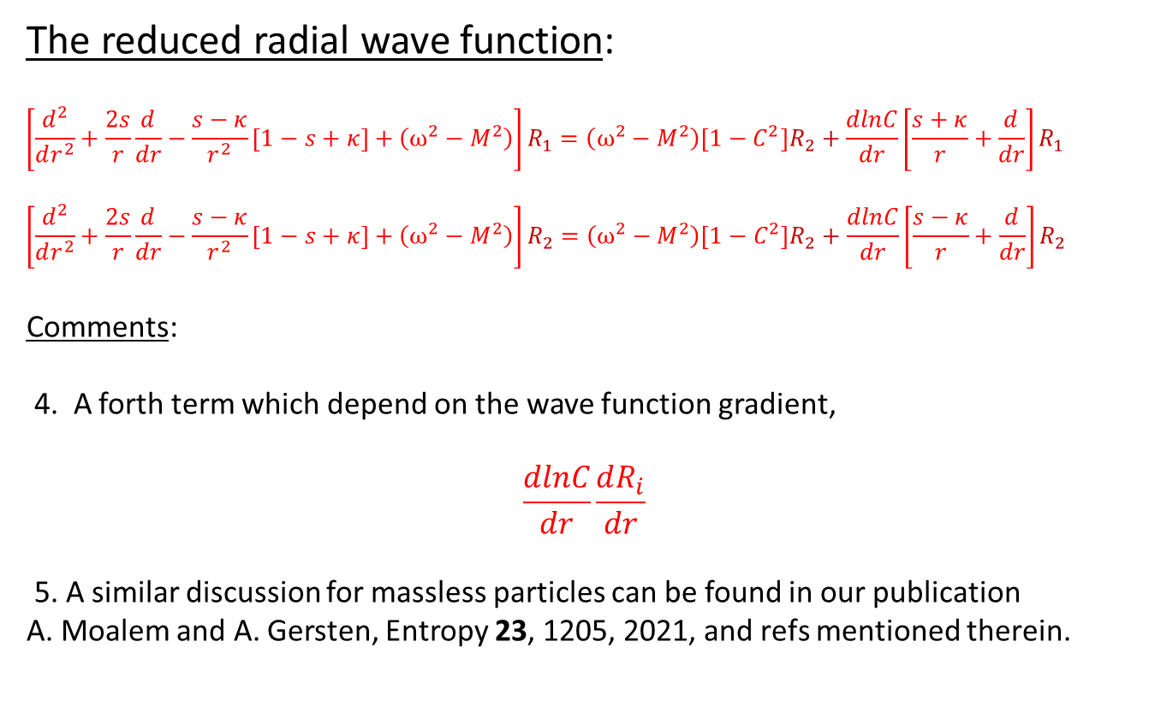
The reduced radial wave function:
$$\left[\frac{d^{2}}{dr^{2}}+\frac{2s}{r}\frac{d}{dr}−\frac{s−κ}{r^{2}}\left[1−s+κ\right]+\left(ω^{2}−M^{2}\right)\right]R_{1}=\left(ω^{2}−M^{2}\right)\left[1−C^{2}\right]R_{2}+\frac{dlnC}{dr}\left[\frac{s+κ}{r}+\frac{d}{dr}\right]R_{1}$$
$$\left[\frac{d^{2}}{dr^{2}}+\frac{2s}{r}\frac{d}{dr}−\frac{s−κ}{r^{2}}\left[1−s+κ\right]+\left(ω^{2}−M^{2}\right)\right]R_{2}=\left(ω^{2}−M^{2}\right)\left[1−C^{2}\right]R_{2}+\frac{dlnC}{dr}\left[\frac{s−κ}{r}+\frac{d}{dr}\right]R_{2}$$
Comments:
4. A forth term which depend on the wave function gradient,
$$\frac{dlnC}{dr}\frac{dR_{i}}{dr}$$
5. A similar discussion for massless particles can be found in our publication
A. Moalem and A. Gersten, Entropy 23, 1205, 2021, and refs mentioned therein.

Slide 28
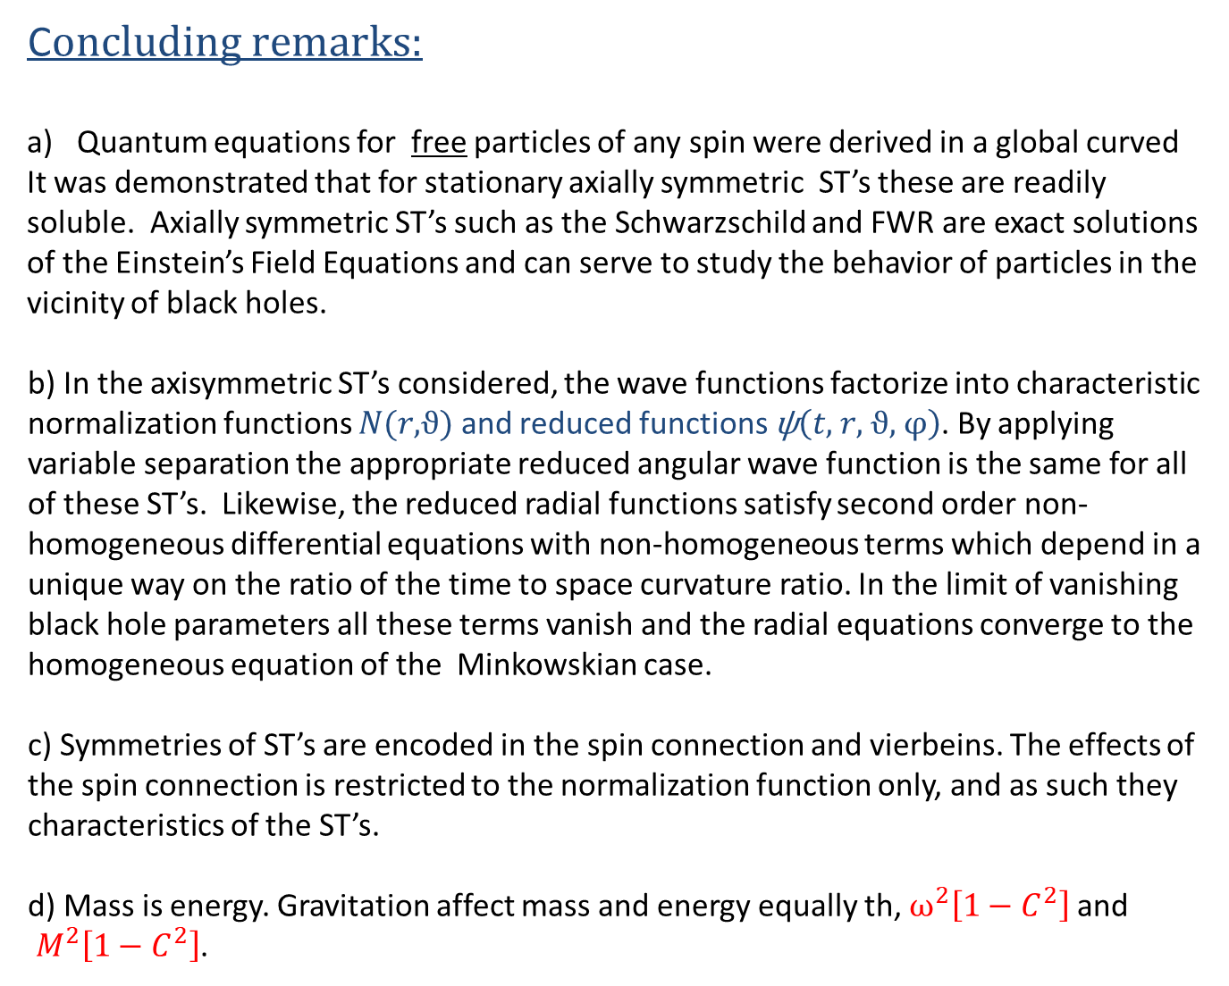
C$oncluding remarks:$
Quantum equations for free particles of any spin were derived in a global curved
It was demonstrated that for stationary axially symmetric ST’s these are readily soluble. Axially symmetric ST’s such as the Schwarzschild and FWR are exact solutions of the Einstein’s Field Equations and can serve to study the behavior of particles in the vicinity of black holes.
b) In the axisymmetric ST’s considered, the wave functions factorize into characteristic normalization functions $N(r,ϑ)$ and reduced functions $\text{ψ}\left(t, r, ϑ, φ\right)$. By applying variable separation the appropriate reduced angular wave function is the same for all of these ST’s. Likewise, the reduced radial functions satisfy second order non-homogeneous differential equations with non-homogeneous terms which depend in a unique way on the ratio of the time to space curvature ratio. In the limit of vanishing black hole parameters all these terms vanish and the radial equations converge to the homogeneous equation of the Minkowskian case.
c) Symmetries of ST’s are encoded in the spin connection and vierbeins. The effects of the spin connection is restricted to the normalization function only, and as such they characteristics of the ST’s.
d) Mass is energy. Gravitation affect mass and energy equally th, $ω^{2}\left[1−C^{2}\right]$ and
$M^{2}\left[1−C^{2}\right]$.

